Slide 1
Smarter Balanced
SBAC: Smarter Balanced Assessment Consortium
A collection of states working together to build an effective and useful statewide assessment system
Completely computer delivered
Assessment Portal
Two main aspects
Summative Assessment
Formative Assessment

Slide 2
Smarter Balanced
*Summative
*Formative

Slide 3
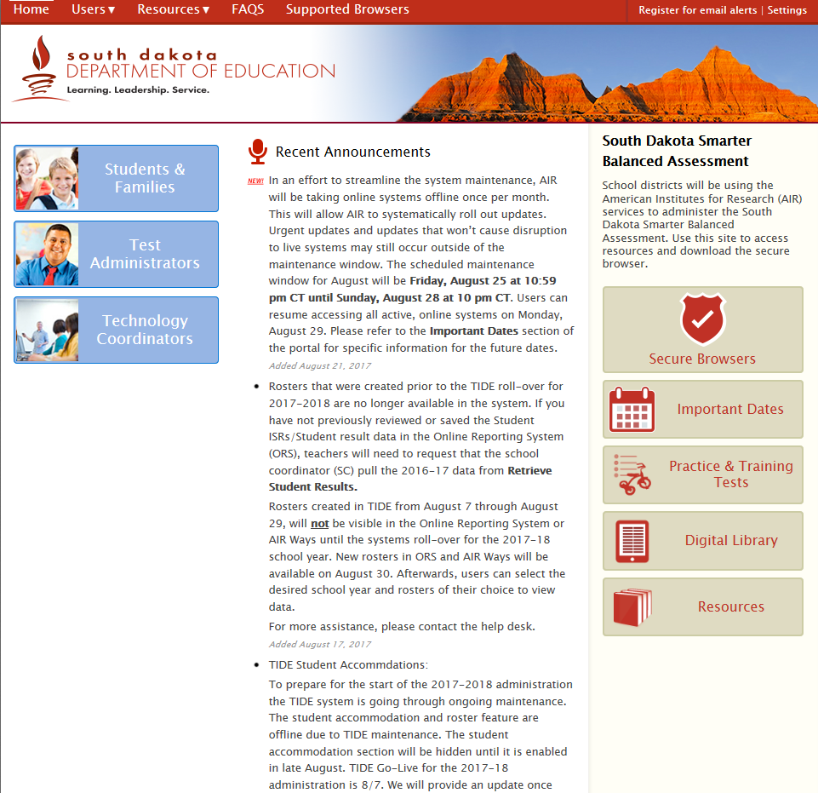
Assessment Portal
Assessment Portal
Entrance Points
Updates
Resources

Slide 4
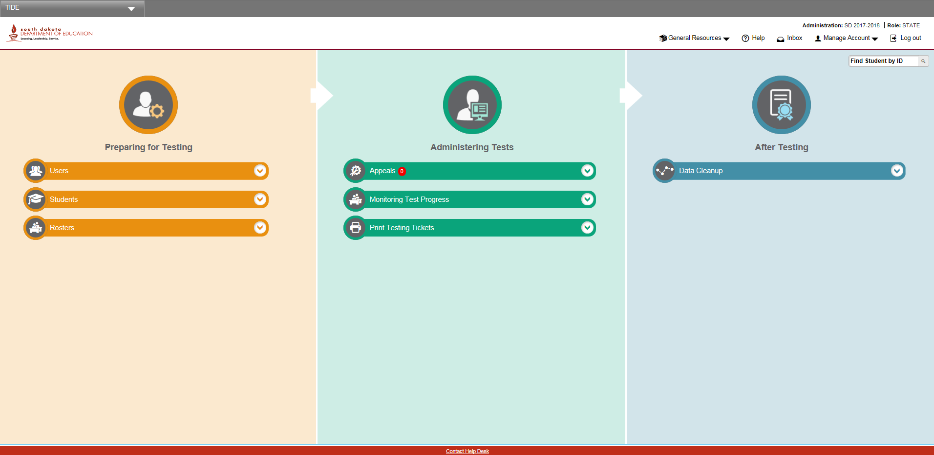
Assessment Portal: TIDE
TIDE: Test Information Distribution Engine
Note: You will need to be well versed with TIDE

Slide 5
Assessment Portal: Resources

Slide 6
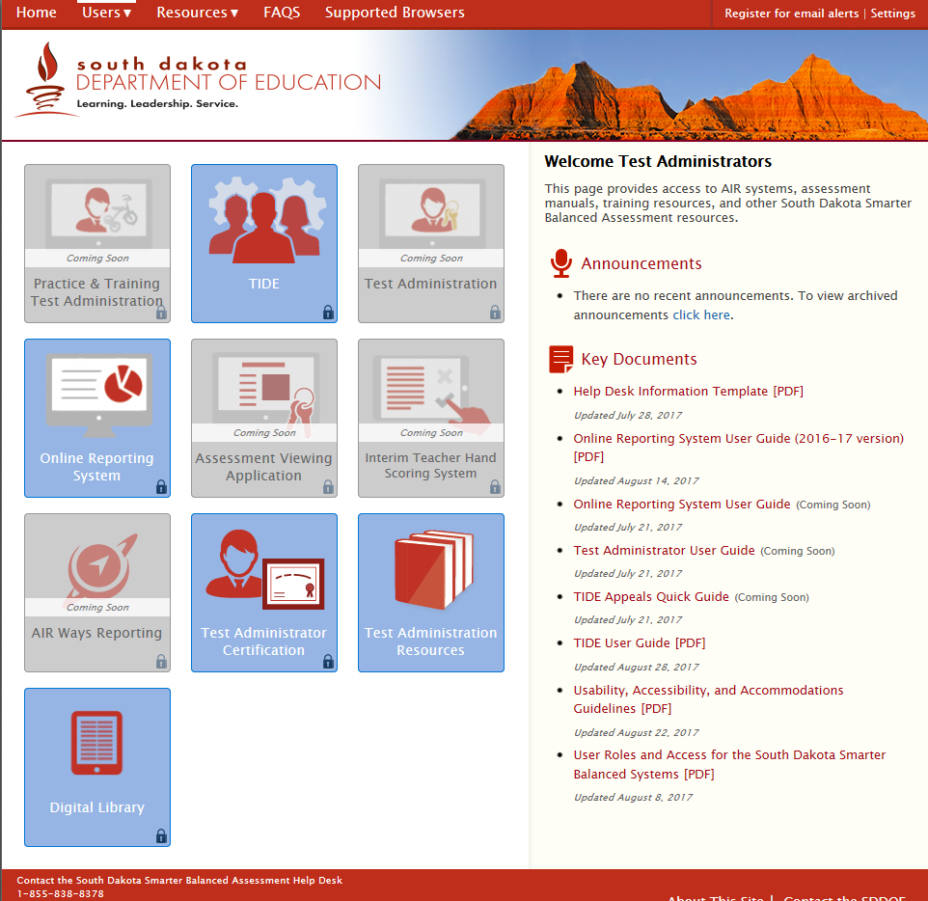
Assessment Portal: Resources
Portal Main Page
User Entrance Page
Multiple places to find support resources
Important Manuals

Slide 7
The Summative Side of the System
Smarter Balanced and the SDDOE provide districts with the end of year summative assessment for…
-students in grades 3,4,5,6,7,8, and 11
-in the content areas of ELA and Math
*ELA and Math Blueprints for assessment specifics

Slide 8
The Summative Assessment
The end of year summative assessment is the accountability piece of the equation.
Results factor into…
Federal and State Reporting
School Report Cards

Slide 9
The Summative Assessment: Before
Timeline/Responsibilities
August:
Assuring Infinite Campus data is being accurately uploaded into TIDE (Work with district Infinite Campus contact)
Create Users
Roster Students
Explore results in ORS

Slide 10
The Summative Assessment: Before
Timeline/Responsibilities
September:
Install secure testing browsers {Work with district Technology Coordinator (TC)}
Distribute information on Interims to administrators, coaches, and teachers

Slide 11
The Summative Assessment: Before
Timeline/Responsibilities
September – February:
Continue to work with district leads in assuring accurate student demographics, rosters, users, and student supports and accommodations
Work with administration in creating a district assessment schedule
Work with TC in assuring computers and technology is prepared and properly functioning
Alert teachers: Interim Comprehensive Assessments go offline February 24th.

Slide 12
The Summative Assessment: During
Timeline/Responsibilities
March:
Summative Assessment window opens March 7th!
Prepare district for the spring summative assessment
In-Service Presentation/Staff Meeting
Assessment schedule
Policies/Procedures
Distribute TAMs (Manuals)
Assure TAs are completing certifications
Be prepared to assist with technical and logistical situations
Collaboration with State contacts and technical assistance

Slide 13
The Summative Assessment: During
Timeline/Responsibilities
March - May:
Monitor and track the completion of all necessary assessments
Continue to assist in any technical or logistical situations
Communication with TAs for the potential of APPEALS
Special circumstances that arise during testing that require documentation supported decisions
Contact with State on APPEALS should be made within 24 business hours of incident
Appeals close the last day of the test window

Slide 14
The Summative Assessment: After
Timeline/Responsibilities
May - June:
Submit Medical Exemption forms and documentation by May 11, 2018
Distribute student results to parents ASAP
Data Cleanup
Data Validation

Slide 15
The Formative Side of the System
Smarter Balanced and the SDDOE provide districts with two resources to support the development of formative assessment within the classroom!
Interim Assessments
Digital Library

Slide 16
Smarter Balanced Interim Assessments
What are they?
Tools provided for global measuring of early, midyear, or periodic progress toward summative assessment targets
Content Standard aligned (Math and ELA)
Same assessment portal and system as the summative assessment
Same assessment platform
Same designated supports and accommodations

Slide 17
Smarter Balanced Interim Assessments
Why use them?
ICA: Interim Comprehensive Assessments
Follow the exact same blueprints as summative
Useful for district/school wide assessment in Math and ELA (Benchmarking)
Determine district/school trends/needs
IAB: Interim Assessment Blocks
Separate SBAC Target aligned blueprints
Useful for classroom teachers at a finer grain in determining the student/instructional needs per target
*For full summary of all Interim Assessments see Fact Sheet handout

Slide 18
Smarter Balanced Digital Library
What is it?
A collection of educator vetted professional learning and instructional resources aligned to SD content standards and Smarter Balanced targets
Created, vetted, and constantly improved by educators from across the nation including our own SD educators
How do you get access?
https://sbdigitallibrary.org/: Sign up here!
SDDOE Digital Library: Tips and support documents

Slide 19
Smarter Balanced Digital Library
Why use it?
Assessment – Supplemental Curriculum – Instruction alignment!
Vetted resources minimize the time needed to search and find useful resources
Forums allow you to communicate with educators from across the country about specific lessons or general practices
User profile functions allow you to create saved lists of resources and store favorites
Opportunities of networking and professional development available to educators looking to become involved in the creation of the Digital Library
Contact Joe Moran for more information @ Joe.Moran@state.sd.us

Slide 20
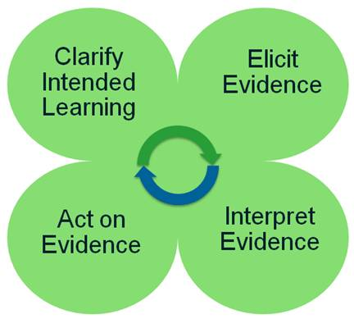
Connecting the System!
Basics
Interims can provide districts/classrooms with a target focus
Digital Library can provide supplementary resources to assist educators in improving classroom instruction and student learning
Formative Assessment Process
The process is a continual cycle!
Allows for a connected and aligned usage of the
assessment system
Playlists
Students are assessed using IABs
Student reports show student performance levels
Playlists provide resources from the Digital Library that have been specifically selected to assist in success achievement of the students at those exact performance levels

Slide 21
Connecting the System!
SBAC Summative Target Blueprint to SD Content Standards Crosswalk
Grade by grade single page printout for every summative assessment target assessed and the corresponding SD Content Standards
Helps associate SBAC targets to our specific state standards
Helps educators dive into the item specifications for improved item writing and classroom formative assessment
Questions about this document? Contact Joe Moran @ Joe.Moran@state.sd.us!

Slide 22
Tools, Supports, & Accommodations

Slide 23
Tools
Embedded (within computer testing platform) and non-embedded (outside of the computer)
Available for all students
Students can choose to use them or not

Slide 24
Supports
Available for some student with an identified need
Process for deciding these needs
Should be documented somehow
Must be using them for instruction before needing for testing

Slide 25
Accommodations
Must be on an IEP or 504 plan
IEP: special education
504: check to see who your 504 coordinator is
Must be used for instruction before using on the assessment

Slide 26
Responsibilities
Special Education Director
Hold IEP meetings to determine supports and/or accommodations
Ensure supports and accommodations are being used for instruction
Work with testing coordinator to enable supports and accommodations
504 Coordinator
Hold 504 meetings to determine needed supports and/or accommodations
Work with staff to ensure being used for instruction
Communicate with testing coordinator to enable supports and accommodations in TIDE
Testing Coordinator
Work with Special Education and 504 Coordinator to ensure supports and accommodations are enabled in TIDE

Slide 27
Timelines
Beginning and during school year
Put in place process used to decide supports needed for some students
Special Ed holds IEP meetings, talk about and document supports and accommodations
Students use supports and accommodations for instruction
Prior to testing
Work with staff to enable student access and use of practice and training site
Ensure supports and accommodations are enable within TIDE
Send documentation for Reading Passages, and Print on Demand to DOE
Ensure Scribe and/or Test Readers are trained
During testing
Monitor supports and accommodations

Slide 28
Resources
Usability, Accessibility and Accommodations Guidelines
Provide in depth information on tools, support, and accommodations for Smarter Balanced
Accommodation Summary
One page summary of tools, supports, and accommodation for Smarter Balanced; and tool and accommodations for SD Science Assessment
Training Protocols
Read Aloud
Scribe
http://doe.sd.gov/octe/SMARTERbalanced.aspx

Slide 29
For Accommodation help:
Contact
Beth Schiltz
Special Ed Office
Beth.Schiltz@state.sd.us
605-773-4257

