Slide 1
South Dakota Principal Effectiveness Model
PE Webinar II
2/02/2023

Slide 2
Domain Four
School, Student and Staff Safety
Notes:
FOCUS: DOMAIN 4

Slide 3
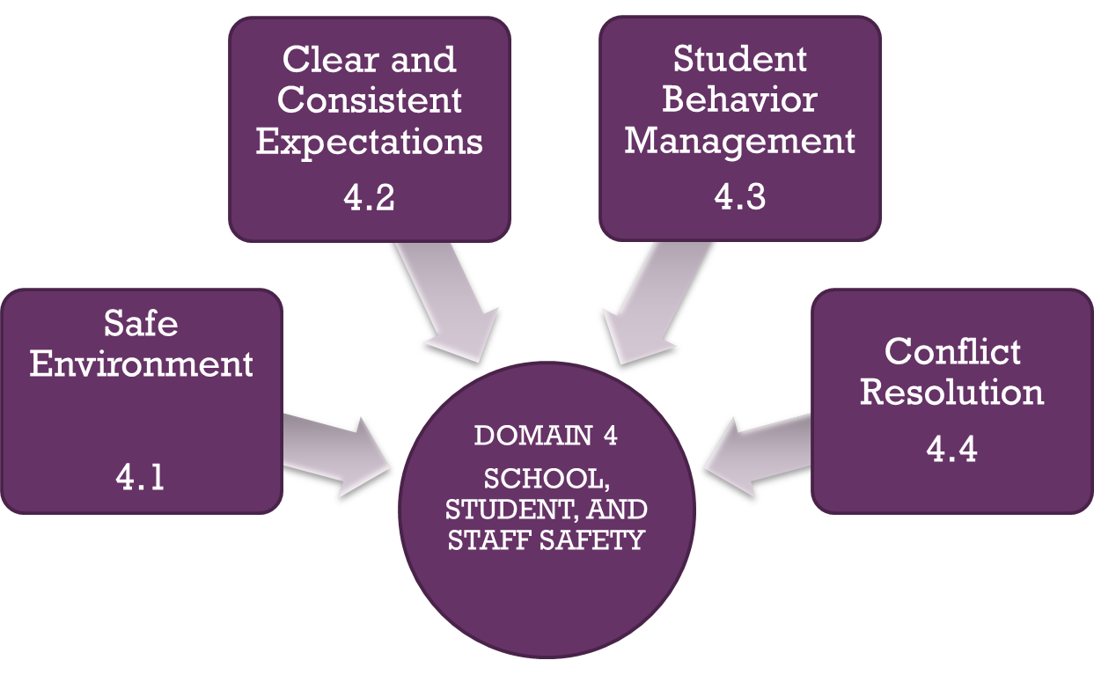
Domain Four

Slide 4
Domain 4.1 – Safe Environment Considerations
Do you have a school-wide crisis plan? If so, with whom did you work to develop the plan, i.e. law enforcement, teacher leader team, emergency management, etc.?
If your school is a separate building from the district office, have you coordinated with the district office so that district office personnel have your plans readily available.
If, during a crisis in the building and for whatever reasons, the building level leaders were unable to communicate with the district level administration or any other outside agency, i.e. law enforcement, what kind of plans do both the district and school have in place for who will take the lead and work with law enforcement. Typically, in a significant crisis, law enforcement takes over but will still need a lead from the district for communication purposes. In most districts, the superintendent would assume that role but who will do so in the absence of the superintendent?
In the event of a crisis within your building, do local law enforcement agencies have blueprints or layouts of your building? Have you invited local law enforcement to your building so that they are familiar with the building?
Crisis plans should not be shared with the public; however, have you developed a communication strategy/plan and made families aware of the communication plan so that they know what to expect and how to respond if a crisis occurs, i.e. through local media, a common cell phone text message from the district, email, a streaming message on website, synervoice (calling system), social media, calling trees, etc.? When families understand that there is a clear communication plan In place, they will much more easily accept that you can not share the actual crisis plans.
Notes:
The goal does not have to be what the state recommends for yearly growth.

Slide 5
Domain 4.1 – Safe Environment Level Comparison and Progression
Establishes routines and policies that promote safety and intermittently supervises implementation.
Fosters emotionally safe environments by ensuring respect among staff and students and respect for cultural diversity.
Addresses safety issues openly, immediately, and constructively.
Establishes routines and policies that promote safety and routinely supervises implementation.
Fosters emotionally safe environments with respect for cultural diversity and divergent opinions.
Supports development and implementation of a plan to insure an emotionally safe environment.
Addresses safety issues openly, immediately, and constructively.
With stakeholders, establishes and continuously monitors safety processes/procedures for their effectiveness.
Makes emotional and intellectual safety a top priority and ensures a culture in which staff and students take responsibility for their own behavior and help others.
Ensures a school culture in which all stakeholders are trained and empowered to take responsibility for their own behavior and help others.
DISTINGUISHED
Notes:
ACCOMPANYING 4.1 RUBRIC

Slide 6
Domain 4.1 – Safe Environment Sample Artifact Progression
Safety policies/procedures
Data from discipline tracker or other records that show how principal has responded to issues dealing with mutual respect
Data reflecting implementation of safety policies/procedures, i.e. fire drills, lockdown drills, etc.
Safety policies/procedures
Logs, data, reports showing routine monitoring
Plans, systems or curricula that support social and emotional safety, i.e. PBIS, district policies, training opportunities, etc.
Safety policies/procedures
Logs, data, reports showing continuous monitoring and review, i.e. PBIS or a like program fully implemented
Agendas with names of stakeholder participants
Plans, systems or curricula that support social and emotional safety, i.e. PBIS, district policies, training opportunities, etc.
Evidence of training for community members
DISTINGUISHED

Slide 7
Domain 4.2 – Clear and Consistent Expectations Considerations
Do you have a clear set of behavioral expectations that are aligned both vertically and horizontally K-12? Do they progress in an age appropriate manner?
How are you communicating codes of conduct/behavioral expectations to students and families, i.e. handbooks, websites, etc.?
Do you look at data related to trends in violations of codes of conduct?
If your data shows trends in violations of codes of conduct, how are you responding?
How do you involve students and staff in the development of behavioral expectations?
Notes:
The goal does not have to be what the state recommends for yearly growth.

Slide 8
Domain 4.2 – Clear and Consistent Expectations Level Comparison and Progression
Distributes written communications about behavioral expectations for staff and students.
Enforces codes of conduct swiftly and fairly.
Communicates behavioral expectations in multiple forms to all stakeholders.
Informs all stakeholders of their responsibilities to behavioral expectations.
Consistently enforces codes of conduct for students/adults and hold adults accountable for consistent enforcement of student expectations.
Links behavioral expectations to mission/vision.
Examines trends in violations of code of conduct and develop initiatives that lead to reduction of violations.
Involves staff and students in developing additional expectations when new issues emerge, i.e. cell phone use, etc.
DISTINGUISHED

Slide 9
Domain 4.2 – Clear and Consistent Expectations Sample Artifact Progression
Sample written communications
Dated data from discipline tracker, logs, or method by which principal monitors discipline
Examples of written, verbal, and electronic means by which principal has communicated behavioral expectations and responsibilities to such to all stakeholders
Dated data from discipline tracker, logs, or other method by which principal consistently holds adults and students accountable to behavioral expectations
Evidence that shows principal has linked messaging about behavioral expectations to vision/mission, i.e. mission/vision consistently referenced in communications about behavioral expectations
Data evidence that shows how principal is examining trends and how he/she is linking new initiatives or updated communications to those trends, i.e. sharing trends with stakeholders when implementing a new communication, initiative, or policy related to behavioral expectations.
Evidence that shows stakeholder involvement in developing expectations around new issues, i.e. agendas, surveys, etc.
DISTINGUISHED

Slide 10
Domain 4.3 – Student Behavior Management Considerations
How have you and your staff worked together to create and enforce common protocols/expectations for both classrooms and common areas?
Do those protocols align with the behavioral expectations/codes of conduct referenced in Domain 4.2?
How are you monitoring the effectiveness of your behavioral plans and the common protocols you have developed.
Are you seeking input from students and parents related to the effectiveness of behavioral plans and common protocols?
Have you considered the implementation of a program such as PBIS (Positive Behavioral Intervention Strategies)? http://doe.sd.gov/oess/sped-pbis.aspx
Notes:
The goal does not have to be what the state recommends for yearly growth.

Slide 11
Domain 4.3 – Student Behavior Management Level Comparison and Progression
Expects teachers and staff to establish rules for student behavior in all areas but allows each teacher to have his/her own rules, protocols, and standards.
Occasionally monitors to ensure that the common expectations are consistently enforced and effective.
Provides positive reinforcement to students for meeting behavioral expectations.
Establishes and implements common expectations for behaviors and routine in common areas.
Works with teachers to establish some common classroom expectations and protocols for student behavior.
Routinely monitors to ensure that common expectations are consistently enforced and effective.
Works with teachers to create a “single school culture” or model for behavior, where all teachers enforce common protocols for classroom behaviors, transitions in the hallways, cafeteria behavior, playground behavior, and other student behaviors related to having an orderly environment.
Routinely monitors to ensure that common expectations in the classroom are consistently enforced and effective.
Collects feedback from students and parents on the effectiveness of the “single school culture” and adjusts, as needed using the input of all stakeholders.
DISTINGUISHED

Slide 12
Domain 4.3 – Student Behavior Management Sample Artifact Progression
Copies of rules staff have established for their areas
Log or other evidence of monitoring
Examples of how positive reinforcement is provided
Student handbook, policies, or other documents detailing behavioral expectations in common areas and classrooms
Log or other evidence of routine monitoring of common behavioral expectations in all areas
Evidence from discipline tracker
Student handbooks, websites, policy manual
Agendas reflecting collaborative development of behavioral expectations in all areas
Student handbook, documents reflecting collaborative development of a single school culture, i.e. any training and work done with PBIS or a like school wide behavioral model
Log or other evidence of routine monitoring of common behavioral expectations in all areas
Evidence from discipline tracker
Evidence from website, trainings, letters home, handbooks, meeting agendas that confirm parents/other stakeholders have been given opportunities for input and evidence of how that input was used to adjust behavioral expectations
DISTINGUISHED

Slide 13
Domain 4.4 – Conflict Resolution Considerations
Have you participated in and/or provided training for staff in conflict resolution?
How have you and your staff worked with students so that they are able to self-manage and appropriately resolve conflicts without adult intervention (when appropriate)?
Have you developed some processes/procedures by which conflicts are resolved starting at the lowest level?
Notes:
The goal does not have to be what the state recommends for yearly growth.

Slide 14
Domain 4.4 – Conflict Resolution Level Comparison and Progression
Helps resolve disputes quickly and constructively.
Fairly facilitates conflict resolution and takes time to listen to all points of view.
Serves as a model and ensures students and staff are taught how to resolve conflicts in constructive ways.
Helps resolve disputes quickly and efficiently and seeks to understand the root cause of conflicts.
Fairly facilitates conflict resolution and takes time to listen to all points of view.
Helps disputing individual understand each other’s position.
Helps disputing individuals understand and accept the best option for resolution.
Quickly, constructively, and effectively deals with issues and analyzes conflicts to identify root cause.
Ensures that all who facilitate conflict resolution are fair
.Helps disputing individual understand each other’s position.
Helps disputing individuals understand and accept the best option for resolution.
Works with staff to teach students self management for productive conflict resolution without adult intervention.
Works with school staff and students to prevent anticipated conflicts from occurring.
DISTINGUISHED

Slide 15
Domain 4.4 – Conflict Resolution Sample Artifact Progression
Data that shows how frequently a single dispute reoccurs, i.e. in discipline tracker or other means by which principal tracks conflict resolution
Surveys of staff and other stakeholders showing perceptions of fairness related to conflict resolution
Agendas or other evidence of training of staff and students in conflict resolution
Data that shows how frequently a single dispute reoccurs, i.e. in discipline tracker or other means by which principal tracks conflict resolution
Surveys of staff and other stakeholders showing perceptions of fairness related to conflict resolution
A documented process that shows individuals understood and accepted the best option for resolution, i.e. a form that disputing individual complete and sign upon resolution of a conflict or documentation in discipline tracker
Data that shows how frequently a single dispute reoccurs, i.e. in discipline tracker or other means by which principal tracks conflict resolution
Surveys of staff and other stakeholders showing perceptions of fairness related to conflict resolution
A documented process that shows individuals understood and accepted the best option for resolution, i.e. a form that disputing individual complete and sign upon resolution of a conflict
Implementation of programs that teach staff and students how to resolve conflicts
Implementation of policies/procedures and/or programs that teach staff and students how to appropriately respond in situations that could escalate to the conflict level
DISTINGUISHED

Slide 16
Domain 4 Sample Artifact List
ADVANCED EDUCATION ACCREDITATION
TITLE I PLANS, LEAP DOCUMENTATION (INDISTAR)
STAKEHOLDER SURVEYS (PARENTS, TEACHERS, STUDENTS, COMMUNITY)
MINUTES OF PLANNING SESSIONS
PROGRESS/DATA ON SCHOOL IMPROVEMENT PLANS
FORMATIVE REVIEWS
SCHOOL, STAFF MEETING AGENDAS
COMMUNITY RESOURCES LEVERAGED BY THE SCHOOL
PUBLIC SERVICES SUPPORTED BY THE SCHOOL
PARENT AND STUDENT HANDBOOKS

Slide 17
Domain 4 Sample Artifact List
CLASSROOM RULES AND EXPECTATIONS
DISTRICT AND/OR SCHOOL WIDE DISCIPLINE MATRIX
PBIS/MTSS PLANS, DATA, AND DOCUMENTATION
DATA FROM DISCIPLINE TRACKER
FAMILY FRIENDLY WALK THROUGH (SDPIRC: SD PARENT RESOURCE NETWORK) http://sdpirc.org/content/goals.htm
CRISIS PLANS
SAFE AND DRUG FREE SCHOOL DATA

Slide 18
Domain 4 PE to TE Crosswalk

Slide 19
Principal Effectiveness Comparison to Turnaround Principles
https://doe.sd.gov/Effectiveness/documents/PE-turnaround.pdf

Slide 20
Principal Effectiveness Tools
https://doe.sd.gov/Effectiveness/Principal.aspx

