Slide 1
South Dakota Principal Effectiveness Model
PE Webinar IV
2/16/2023

Slide 2
Domain Three
School Operations and Resources
Notes:
Summary of Domain 3: Effective principals/assistant principals manage school operations efficiently by understanding the budgeting process, by identifying and procuring outside funding, and by obtaining the most effective teachers and staff in order to maximize student learning. Effective principals provide staff members with leadership opportunities, support change initiatives that are geared toward eliminating learning gaps, and create an environment that is nurturing to both students and adults.

Slide 3
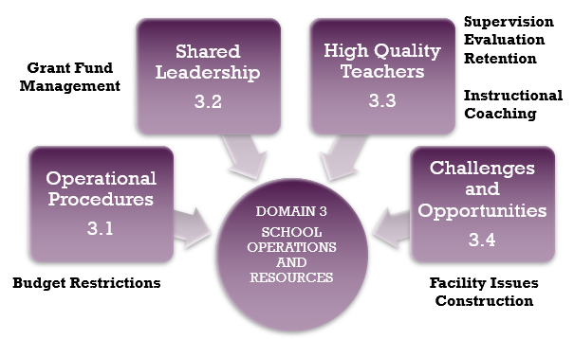
Domain Three
School Operations and Resources
Notes:
Again, turn to page 83. Read the Paragraph

Slide 4
Operational Procedures
Domain 3.1

Slide 5
Operational Procedures Considerations
When determining human, financial, and other needs, do you have a process or processes for prioritizing those needs based upon maximizing student success? If so, what are those processes?
When you submit your budget requests (human, financial, and other), do you use data to support your requests? If so, how? Do you look at the most current data or do you consider data from an historical perspective? When is it appropriate to look at data from an historical perspective and when is it appropriate to consider the most current data?
If you have allocated resources (human, financial, and other) toward specific outcomes, would you be able to provide data(both current and historical) that shows progress/lack of progress toward those specific outcomes?
Do you seek resources outside the district budget, i.e. grants, etc.? If so, what kind of process/processes do you have in place to determine the grant’s applicability to the needs of your district? Do the goals and purposes of the grant align with the specific student needs/goals of your school or district?
If you are seeking a grant or some other outside resource, do you have the in-house resources to manage the grant-specifically the accountability requisites?
How do you work with stakeholders when determining your resource needs (human, financial, and other)?
How do you balance general fund needs with capital outlay needs-especially in light of state legislation that allows for broader use of capital outlay dollars? Do you have a data driven process that assists you in making decisions related to the broader use of capital outlay dollars?

Slide 6
Operational Procedures Level Comparison and Progression
Allocates human, financial, and other resources using the past as a guide rather than basing decision on current need.
Occasionally uses budgets to focus on school improvement priorities.
Demonstrates knowledge of the alignment of school budget, human resources, and technological resources.
Leverages knowledge of the budgeting process to maximize all available dollars and other resources to achieve strategic priorities.
Effectively manages school budget, determines staff assignments, and technological needs to address student learning needs.
Obtains and allocates funds within the framework of federal, state, and district policies.
Works with staff to determine equitable and effective allocation of resources.
Has established processes to leverage existing funds and increase capacity through grants, donations, and community resourcefulness.
Works with all appropriate stakeholders to ensure strategic and equitable allocation of financial, human, and technological resources to meet instructional goals.
DISTINGUISHED

Slide 7
Operational Procedures Sample Artifact Progression
Rudimental budget documents based upon the past as the guide.
Budget documents showing how all resource requests align with the School Improvement Plan or School Wide Goals
Sample budget requests/documents that reflect principal’s knowledge of various funding sources and how those sources should be used according to district, state, and federal guidelines, i.e. Title, capital outlay, general fund, special education
Staffing and scheduling documents aligned with the School Improvement Plan or School Wide Goals
Budget documents showing how all resource requests align with the School Improvement Plan or School Wide Goals
Sample budget requests/documents that reflect principal’s knowledge of various funding sources and how those sources should be used according to district, state, and federal guidelines, i.e. Title, capital outlay, general fund, special education
Staffing and scheduling documents aligned with the School Improvement Plan or School Wide Goals
Examples of how principal has increased funding capacity through grants, donations, and other community resources
Evidence that these outside resources, i.e. grants, etc. align with the School Improvement Plan and/or School Wide Goals and evidence of goal attainment because of these resources
Evidence of how principal has worked with stakeholders in procurement and allocation of resources
DISTINGUISHED
Notes:
Spend time on this artifact list-particularly the distinguished column.

Slide 8
Shared Leadership
Domain 3.2

Slide 9
Shared Leadership Considerations
What kind of leadership opportunities do you provide for staff?
Do you facilitate or make accessible to your staff mentoring programs that promote leadership?
When you delegate leadership tasks to staff, do you give them the authority to successfully complete the task?
How do you monitor progress and completion of delegated tasks?
How do you recognize and/or celebrate staff members who seek out leadership responsibilities?
How do you work with staff in fashion that develops their ability to manage tasks and responsibilities?
How are you tying the leadership discussion with the Danielson Model, particularly Domain 4: Professional Responsibilities?

Slide 10
Shared Leadership Level Comparison and Progression
Occasionally delegates tasks that could and should be done by others.
Provides feedback for staff leaders to help them acquire skills.
Recognizes the need for distributed leadership in the management of the organization.
Shows a clear pattern of delegated decisions conferring authority to match responsibility.
Provides leadership development opportunities for staff to help them acquire leadership skills.
Outlines leadership expectations for staff leaders and holds them accountable for outcomes.
Creates a climate of respect for staff who are serving as leaders.
Provides opportunities for staff members to participate in the facilitation of meetings and exercise leadership in committees and task forces.
Also provides opportunities for noncertified staff to exercise appropriate authority and assume appropriate leadership roles.
Proactively identifies and supports potential leaders.
Provides leadership development opportunities for staff designed to enhance management of the organization.
DISTINGUISHED

Slide 11
Shared Leadership Sample Artifact Progression
List of teacher leadership roles or delegated tasks within the school.
Evidence of monitoring of completion of delegated tasks, i.e. agendas and/or other work products, logs, meeting with teams.
Evidence of how principal mentors teacher leaders, i.e. formative feedback samples, agendas of trainings, logs of mentoring time with teacher leaders.
Evidence through Danielson: Domain 4, i.e. evaluations.
Evidence that all emerging leaders have leadership and growth opportunities, i.e. a systematic and ongoing plan developed and led by a teacher team.
Evidence of monitoring of progress and completion of delegated tasks, i.e.. agendas and/or other work products, logs, meeting with teams.
Evidence of how principal mentors teacher leaders, i.e. formative feedback samples, agendas of trainings, logs of mentoring time with teacher leaders.
Evidence through Danielson: Domain 4, i.e. evaluations.
A systematic process in which emerging leaders are recognized and given the authority to lead, i.e. mentoring and/or leadership program, SD Instructional Coaching, an ongoing plan developed and led by a teacher team.
A systematic process for recognition and celebration of emerging leaders.
Training that develops the ability of staff to manage tasks and responsibilities.
Evidence of Danielson: Domain 4.
DISTINGUISHED

Slide 12
Shared Leadership Opportunities
Teachers as mentors-both local and state
Teachers as literacy or math leaders
Teachers as coaches, i.e. SD DOE Coaching Program for Reading
Support of teachers as members on committees both local, state, and national, i.e. curriculum, instructional council, hiring, etc.
Department chairpersons; grade level leaders
District and school level leadership teams, i.e. PBIS teams, data teams, PLC teams, BLT
Internship opportunities
Participation in programs both internal and external that support aspiring leaders, i.e. MAPLE’s yearly Aspiring Leaders program, Porthan training, SD DOE Coaching for Reading
Support and encouragement of teachers seeking National Certification
Notes:
The goal does not have to be what the state recommends for yearly growth.

Slide 13
High Quality Teachers
Domain 3.3

Slide 14
High Quality Teachers Considerations
What are your hiring processes/procedures?
When hiring, what selection criteria do you consistently use to assess a candidate’s skills and potential “fit” within the staff culture, within a grade level team, within a content area team.
When hiring, does your selection criteria assess whether a candidate has specific strengths that you are seeking to balance strengths that already exist within the whole school culture and within team cultures?
Assuming that you have fully implemented the Danielson model for teacher evaluations, what is your progress with providing individualized and timely formative and summative feedback?
Are you using evidence-based feedback in your formative and summative conversations with teachers
What steps have you taken in the formative and summative feedback process to facilitate teachers becoming more reflective about their own practice?
Notes:
We are in the process of planning a June workshop that will focus on providing evidence based feedback and engaging in both formative and reflective conversations with teachers about their practice. The dates for the workshop are June 20-June 24. There will be five day long workshops in various sites across the state. Go to South Dakota Go Sign Me Up for more details.

Slide 15
High Quality Teachers Considerations
Consider the following quotes and how they apply to your practice?
Good coaching helps a person move from where they are to where they want to be (Aguilar, 2011).
Coaching cannot be mandated and cannot be a requirement. Once trusting, respectful relationships are in place, principals can effectively serve as coaches and help teachers reflect on and improve their teaching (Williamson, 2012)

Slide 16
High Quality Teachers Level Comparison and Progression
Has general selection criteria to perform a detailed assessment of potential staff knowledge, skills, and dispositions.
Analyzes teacher evaluations to determine retention.
Occasionally retains teachers based upon factors other than performance.
Fairly and consistently evaluates school personnel.
Hires teachers with philosophies of teaching and learning similar to other teachers in school.
Has clear and articulated selection criteria to assess skills and “fit” with school culture and staff.
Implements a formal retention strategy and gives retention offers based on effectiveness.
Fairly and consistently evaluates personnel in accordance with state and district guidelines.
Provides timely and constructive feedback focused on improved student learning.
Implements clear selection criteria and places teachers in grade level and content areas to create a balanced collegial team with a variety of strengths.
Routinely provides staff with individualized timely, constructive formative and summative feedback.
Provides effective coaching for all teachers.
Provides research based professional learning opportunities that have been shown to have strong impacts on populations of students similar to the students in the principal’s school.
DISTINGUISHED
Notes:
Both the DOE based coaching program and the Porthan training focus on the principal as an instructional coach.

Slide 17
High Quality Teachers Sample Artifact Progression
Selection criteria for hiring process.
Data reflecting alignment of evaluations to retention.
Data reflecting consistent and fair evaluation of school personnel.
Selection criteria that aligns to philosophy of teaching and learning within the school.
Selection criteria that assesses staff skills and staff fit with school culture.
A formal retention strategy/process-based teacher evaluations and teacher effectiveness.
Evidence that personnel are evaluated in accordance with state and district guidelines.
Selection criteria that aligns to philosophy of teaching and learning within the school and places teachers in appropriate grade and content teams.
Selection criteria that assesses staff skills and staff fit within school culture.
A formal retention strategy/process based on teacher evaluations and teacher effectiveness.
Evidence that personnel are evaluated in accordance with state and district guidelines.
Logs/sample feedback forms, sample evaluations etc. as evidence of formative and summative feedback
Evidence of a coaching process.
Evidence of professional learning related to specific needs of the school.
DISTINGUISHED

Slide 18
Challenges and Opportunities
Domain 3.4
View of Apollo 13 astronauts changing one of the modified LiOH canisters.
Image Number: AS13-62-9004
Credit: NASA

Slide 19
Challenges and Opportunities Considerations
How do you monitor school operations such as expenditures, food service, facilities maintenance, etc.?
Managing school operations can consume a principal’s time. How do you balance your role as an educational leader with your role as a manager of multiple operations?
How will you move your role as a manager of school operations from a reactive position to a proactive position?
How do you involve stakeholders in this process?
Notes:
The goal does not have to be what the state recommends for yearly growth.

Slide 20
Challenges and Opportunities Level Comparison and Progression
Demonstrates emerging awareness of challenge that may inhibit school effectiveness and efficiency.
Annually reviews performance indicators to ensure that school operations are within budget and are supporting effective teaching and learning.
Monitors school operations to identify any area that is not operating optimally and puts an action plan in place to address any areas of concern-especially those areas that affect teaching and learning.
Analyzes resource allocations to ensure resources are being used efficiently and effectively.
Is proactive at identifying potential challenges that inhibit school operations.
Looks for early warning signs for any operational area where issues might be emerging.
Routinely studies key operational performance indicators and makes improvements as needed to increase efficiency and effectiveness.
Engages staff in providing feedback and making decisions.
DISTINGUISHED
Notes:
ACCOMPANYING 4.1 RUBRIC

Slide 21
Challenges and Opportunities Sample Artifact Progression
Annual performance review checklists.
An example whether observed or in writing of principal having dealt with at least one issue/challenge related to school operations.
A specific plan/process for the regular monitoring of school operations, i.e. checklists, evaluation process for non-certified personnel, stakeholder surveys, etc.
Evidence in writing or through a meeting with superintendent/evaluator or annual report to Board of Education of principal having analyzed resource allocations for efficiency and effectiveness.
Evidence in writing or through a meeting with superintendent/evaluator or annual report to Board of Education of principal identifying potential challenges related to school operations and procedures.
Evidence in writing (agenda, minutes, etc.) or through superintendent/evaluator observation that principal engaged staff in decision making related to school operations and procedures-especially those that impact student learning.
DISTINGUISHED

Slide 22
Domain 3 Sample Artifact List
Stakeholder surveys
Minutes of planning sessions
Progress on school improvement plans
School/staff meeting agendas
Staffing plans
Teachers’ professional learning opportunities aligned to teacher domains
Hiring calendar and process
School budget
Teacher turnover rates
Completed teacher evaluations
Teacher professional growth plans
Public services supported by the school
School web-site
Principal

Slide 23
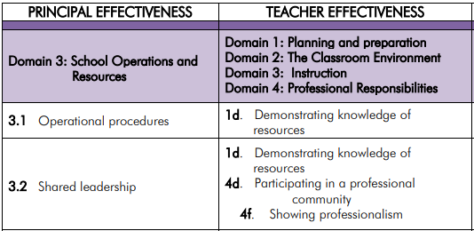
Domain 3 PE to TE Crosswalk

Slide 24
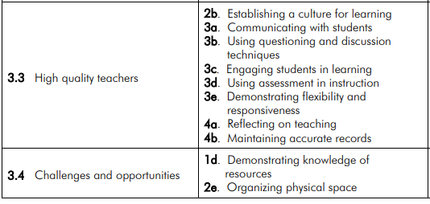
Domain 3 PE to TE Crosswalk

Slide 25
Principal Effectiveness Comparison to Turnaround Principles
https://doe.sd.gov/Effectiveness/documents/PE-turnaround.pdf

Slide 26
Principal Effectiveness Tools
https://doe.sd.gov/Effectiveness/Principal.aspx

