Slide 1
SPED Teacher Effectiveness Training
Brandi Gerry MaryLou McGirr William Kliche

Slide 2
Outcomes
Gain an understanding of the SD Teacher Effectiveness Model
Create an understanding of Student Learning Objectives
Develop an awareness of the SPED Scenarios in relation to the SD Framework for Teaching

Slide 3
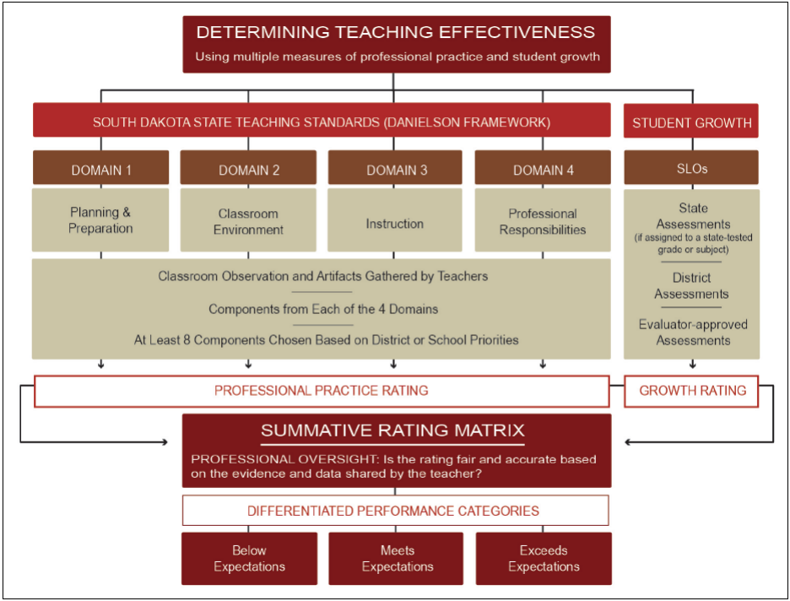
Determining Teaching Effectiveness
Notes:
Review with teachers the Teacher Effectiveness Model.
Focus in on the Student Growth Area (SLO) as that is the purpose of this training.
The South Dakota Teacher Effectiveness Model is a collection of recommended practices that serves as guidance toward successful implementation of high quality teacher evaluation systems. Practices outlined in the model are not required. Public school districts have the freedom to implement evaluation systems that differ from the model, provided a locally-developed system complies with all minimum state requirements. South Dakota’s Teacher Effectiveness Model establishes clear performance expectations, identifies multiple performance measures, includes recommendations for evidence collection and provides guidance to meaningfully determine and differentiate teaching performance.

Slide 4
South Dakota Framework for Teaching
Notes:
The Professional Practice Rating represents aggregate performance on all evaluated components (min of 8: 1 from each domain)
Evaluations of professional practice are guided by standards-based rubrics and supported by evidence gathered by the evaluator and teacher. Once component-level performance is determined, the evaluator assigns a numerical value to component-level performance and calculates an average score across the evaluated components. This average score translates into one of four levels of performance: Unsatisfactory, Basic, Proficient, or Distinguished.
Student Growth Rating – calculated based on growth within SLO

Slide 5
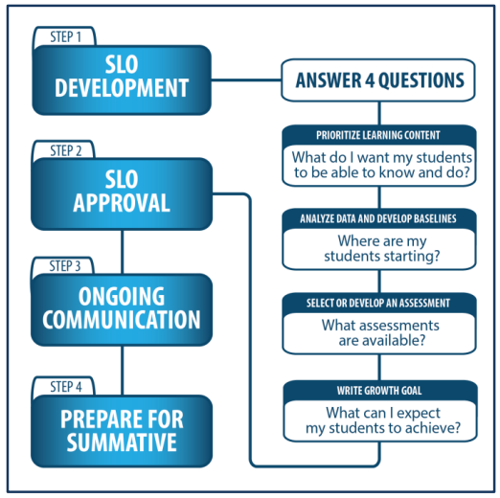
SLO Process
Low Growth: Growth goal is less than 65% attained.
Expected Growth: Growth goal is 65%-85% attained.
High Growth: Growth goal is 86% to 100% attained.
Notes:
Teacher goes through SLO process (we will discuss in depth later) and at the end of the cycle, calculates growth based on percent of goal attainment.

Slide 6
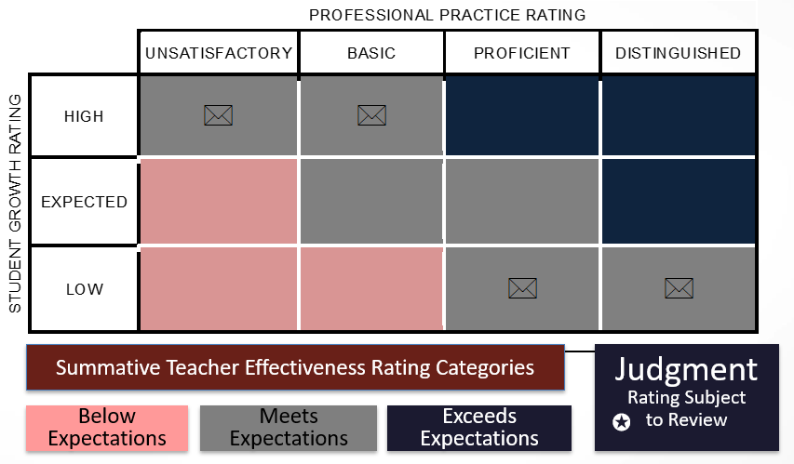
Summative Scoring Matrix
Notes:
Show teachers where the student growth rating fits in on the matrix.
Using the recommended model, public school districts will separately determine a Professional Practice Rating and a Student Growth Rating. The two separate ratings are combined by using the Summative Rating Matrix, a tool that provides educators the opportunity to exercise professional judgment prior to classifying teacher performance into one of the three performance categories. This model of combining the two ratings does not rely on a uniform formula to calculate a Summative Teacher Effectiveness Rating. Instead, the model prioritizes evaluations based on the South Dakota Framework for Teaching, while incorporating the evaluation of student growth as one significant factor in the rating system. Determining Teacher Effectiveness based on the recommended model is described in detail in the remaining portions of the South Dakota Teacher Effectiveness Handbook.

Slide 7
One Year Evaluation Cycle
Notes:
SPED teachers go through the same process, but with their “SPED” glasses on.
I.E. – your caseload, job assignment, student IEP goals, administrator directions, etc… will have an effect on which students are included, the subject area chosen, the goal(s) you set.
Taken from SLO Handbook

Slide 8
SPED Law/Guiding Principles
SLOs should support the participation of students with disabilities in the general education curriculum to the maximum extent possible.
SLOs should be developed in a way that holds all teachers accountable for the academic growth of SWDs.
ARSD 24:05:13:02 Free Appropriate Public Education
Notes:
Here are some things to keep in mind when create your SLO.
The next several slides will look at each of these principles in more detail.
ARSD 24:05:13:02 Free Appropriate Public Education - FAPE must be provided to any child found eligible for special education and related services
ARSD 24:05:27:01.03(2)(a) - Must meet the students needs so he/she is enabled to be involved and progress in the general education curriculum

Slide 9
SPED Law/Guiding Principles
SLOs should support the participation of students with disabilities in the general education curriculum to the maximum extent possible.
SLOs should not be based on the attainment of IEP goals.
SLOs should focus on academic standards.
The structure of the IEP process can inform the development of SLOs.
Notes:
The IEP can be a helpful document in determining what area to focus on, but should not be the only factor.
The IEP is a legal document, and using it as your SLO is not okay.
Let’s dig into each of these considerations.

Slide 10
Consideration 1
Consideration 1: SLOs should not be based on the attainment of individualized education program (IEP) goals.
Students with disabilities, when appropriate, should be instructed and assessed using the same college and career readiness standards as their general education peers.
IEPs are legal documents designed to ensure individualized services to students with disabilities based on their needs. Including IEP goals within teacher evaluation systems may unintentionally move the focus away from the student.
IDEA 2004
“Position on Special Education Teacher Evaluation” 2012
Notes:
Individuals with Disabilities Education Act 2004:
“To the maximum extent appropriate, children with disabilities, including children in public or private institutions or other care facilities, are educated with children who are not disabled, and special classes, separate schooling, or other removal of children with disabilities from the regular education environment occurs only when the nature or severity of the disability of a child is such that education in regular classes with the use of supplementary aids and services cannot be achieved satisfactorily.”
The Council for Exceptional Children published a “Position on Special Education Teacher Evaluation” in 2012.
The position statement does not support the use of progress on IEP goals as a measure of growth for teacher evaluation. (bottom of first page)

Slide 11
Consideration 2
Consideration 2: SLOs should focus on academic standards.
SLOs are written for content-area standards. Special education is not a content area.
However, SLOs written to encompass special education populations may differ in their established learning targets AND the types of services and supports provided to students with disabilities to access the general education curriculum.
Notes:
Student growth in a specific content area should be measured in the environment where they receive the majority of their instruction in that content area.
Ex: If you have a student who receives accommodations/modifications for an SLD in reading, he/she should receive those same accommodations/modifications when assessing/instructing for your SLO.

Slide 12
What About Functional Skills?
There may be occasions in which an SLO needs to be written to address a functional skill, such as communication.
In these infrequent instances, the SLO should:
Address a skill critical to learning content
Address a skill essential for showing what the student knows and/or can do related to the content
Be instructed and assessed within the context of content-based activity(ies)
Be written within any one of the 4 previous accountability models
Notes:
Step 3 of the process guide is to document your interval of instruction, or the time frame in which you will measure student growth. For most teachers, this will be a semester or school year. SLOs are intended to encompass the larger academic standards within a course or content area. It is important that the duration of the SLO spans the full length of time students are with their teacher for instruction. If you are unsure of the time frame you should select, contact your district evaluator.

Slide 13
Consideration 3
Consideration 3: The structure of the IEP process can inform the development of SLOs.
IEPs can be a source of evidence within the SLO process to document the types of services and supports that were provided to help students with disabilities achieve the standards.
The IEP also may include documentation of student progress that could be a valuable source of evidence for SLOs.
Don’t forget related service providers!
Notes:
Ex: past student progress can help ID growth trends
STAR: What types of services and supports may be needed from related service providers to help SWDs achieve their targets?
Special education teachers can leverage work already performed within the context of the specialized instruction outlined in the IEP to gather data for SLOs.
Progress monitoring
Specialized assessments
Team structures

Slide 14
Consideration 3: Structure
Consideration 3: The structure of the IEP process can inform the development of SLOs.
SLOs require: | IEPs require
Collection of baseline data | A statement of present levels of performance
Expected growth targets | Expected growth and attainment
Measurement of student progress | Statement of progress monitoring measures
Instructional strategies | Supports and accommodations
Notes:
SLOs and IEPs share many of the same components.
Keep in mind: Focus needs to remain on teacher, not student goal attainment!
SLOs and IEPs share many of the same components.
Keep in mind: Focus needs to remain on teacher, not student goal attainment!

Slide 15
SPED Law/Guiding Principles
SLOs should be developed in a way that holds all teachers accountable for the academic growth of SWDs (ARSD 24:05:13:02 Free Appropriate Public Education)
Special education teachers should use the same SLO template and process that is used by other teachers in the district.
In co-teaching situations, general education and special education teachers should collaborate to create SLOs.
SLOs for special education teachers must reflect the diverse education settings found in the continuum of special education services.
Notes:
Remember, this was the second principle to follow.
Let’s take a look at each of these considerations more closely
ARSD 24:05:13:02 Free Appropriate Public Education - FAPE must be provided to any child found eligible for special education and related services
ARSD 24:05:27:01.03(2)(a) - Must meet the students needs so he/she is enabled to be involved and progress in the general education curriculum

Slide 16
Consideration 4: Special education teachers should use the same SLO template and process that is used by other teachers in the district.
Potential SLO Differences
Which standards? (ex: CCSS, other academic area, CCC) Progression of skills needed to access the curriculum? Grade-level of the curriculum Participation in gen ed assessments Matching instructional methods to SLO goals
Notes:
A unified template and process reinforces the expectation that all teachers are accountable for student growth.
REMINDER: Sped teachers ARE NOT required to write an SLO for every student on their caseload.

Slide 17
Consideration 5: In co-teaching situations, general education teachers and special education teachers should collaborate to create SLOs.
It may be appropriate for the general ed and special ed teacher to share the SAME SLO and results.
Consider a TEAM SLO in this case.
Notes:
If the group you are planning to use for your SLO is a group you teach collaboratively with a gen-ed teacher (push-in situation), keep this in mind.
In this situation, may be appropriate for gen ed and sped teacher to share same SLO and results.
This would be a situation where they may want to consider a Team SLO

Slide 18
Consideration 6: SLOs for special education teachers must reflect the diverse education settings found in the continuum of special education services.
Consider:
Interval of instruction Pacing Repetition, spiraling Frequency and/or intensity for supports
Notes:
Think about your target group. Where do they receive instruction?
Settings Ex: Inclusion, Resource Room, Self-Contained Room
Again, this is where the different “Types of SLOs” should be considered.

Slide 19
Target Group
If you are writing an independent SLO consider your target audience.
You want your SLO to reflect your instruction.
Target audience should be students you significantly impact in that subject area.
Example: If you work with a group of students daily in reading, they would be a good group to target in your SLO.
Notes:
If you have students on your caseload that do not receive instruction from you, they would not be a good target group for an independent SLO.

Slide 20
Writing Effective SLO Growth Goals

Slide 21
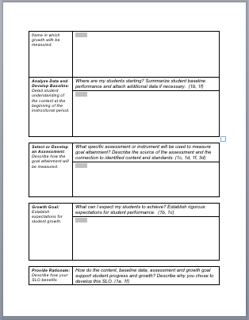
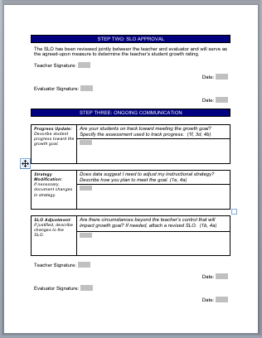
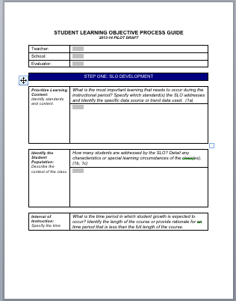
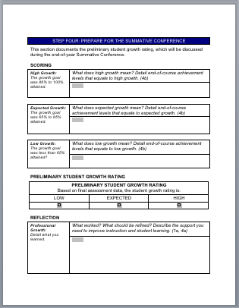
SLO Process Guide
Notes:
The process guide – helps to guide the teacher through all the steps of developing the SLO through determining growth.

Slide 22
Prioritizing Learning Content
Prioritize Learning Content: Identify standards and content. | What is the most important learning that needs to occur during the instructional period? Specify which standard(s) the SLO addresses and Identify the specific data source or trend data used. (1a)
 | STATE STANDARDS FOR YOUR STUDENTS’ GRADE LEVEL CORE CONTENT CONNECTORS (if applicable)

Slide 23
Identify Student Population
Identify the Student Population: Describe the context of the class. | How many students are addressed by the SLO? Detail any characteristics or special learning circumstances of the class(es). (1b, 1c)
 | SHARED – WHOLE CLASS INDIVIDUAL – YOUR STUDENTS

Slide 24
Interval of Instruction
Interval of Instruction: Specify the time frame in which growth will | What is the time period in which student growth is expected to occur? Identify the length of the course or provide rationale for a time period that is less than the full length of the course.
 | SCHOOL YEAR SEMESTER

Slide 25
Analyze Data & Develop Baseline
Analyze Data and Develop Baseline: Detail student understanding of the content at the beginning of the instructional period. | Where are my students starting? Summarize student baseline performance and attach additional data if necessary. (1b, 1f, 3d)
 | WHAT IS/ARE YOUR DATA SOURCE(S) WHERE ARE YOUR STUDENTS STARTING
Notes:
Every SLO has to have starting point – this is the baseline data you use to determine your area of growth

Slide 26
Select or Develop an Assessment
Select or Develop an Assessment: Describe how the goal attainment will be measured. | What specific assessment or instrument will be used to measure goal attainment? Describe the source of the assessment and the connection to identified content and standards. (1c, 1d, 1f, and 3d)
 | SAME AS CLASSROOM TEACHER? OWN ASSESSMENTS? Interval of instruction Pacing Repetition, spiraling Frequency and/or intensity for supports
Notes:
After you’ve collected and analyzed your data, what assessment will determine your starting point?

Slide 27
Growth Goals are the HEART of the SLO They are S.M.A.R.T

Slide 28
S.M.A.R.T. Goals
S
Specific
The goal addresses student needs within the content.
M
Measurable An appropriate instrument or measure is selected to assess the goal.
A
Appropriate
The goal is standards-based, needs-focused (and directly addresses all students in your target group)
R
T
Realistic & Rigorous
The goal is attainable and stretches student learning.
Time-bound
A time frame is included in the goal (ex: year, semester).
Notes:
Review each part of the acronym.
S – states exactly what learning content needs to be addressed, content is aligned to credible standards
M – appropriate measurement tool, states increment to measure
A – developed using baseline data, includes growth for all students
R – stretches outer boundary of what is attainable
T – includes a time frame, data collected throughout the time frame

Slide 29
Sample Growth Goal
By the end of the year, students will move from below benchmark to at or above benchmark for the FSF (First Sound Fluency) and PSF (Phoneme Segmentation Fluency) DIBELS Next assessments.
By the end of the unit, all 8 students in the class will score a 70% or higher on the end-of-unit assessment with no prompting. The students’ required accommodations will be used.
NOTICE:
Neither of these say, “80% of students will …”
Why?
Notes:
Ask teachers to choose one of these goals and ID each of the SMART components
Key:
Specific – states content-based learning focus
Measurable – includes your assessment and measurement (ex: minutes, points, percent, etc…)
Appropriate – includes growth for ALL students in your target group
Realistic/Rigorous – based on pre-assessment/current knowledge of students’ abilities
Time Bound – includes a time frame
NOTICE: We are not saying 80% of students will …. Why? Is it okay for 10, 20, 30% of students to NOT increase/reach goal/score X….?
From presentation by Michele Davis

Slide 30
Focus on Growth
When writing SLOs think about the growth desired. Keep the focus on the growth of all students, not the number of students achieving the goal.
Notes:
Remember to focus on growth for all, not a number of students who can achieve the goal

Slide 31
Focus on Growth
Amount of students
Amount of growth
80% of the students in my target group will test at level 4.5 or higher in the district reading assessment.
Students in my target group will move up by at least 1.5 grade levels in reading in the district reading assessment.
Notes:
Here are a couple of goal examples.
First click – two children WONT reach the goal
Second click – goal for all students in my group
Images from Pixabay.com

Slide 32
Growth Goals
Class Mastery
Based on quality baseline data and educator-determined definition of mastery. Goal is structured based on all students attaining mastery.
Differentiated Growth
Establishes tiered expectations for student growth for groups of students. The educators define what growth looks like for each group of students.
Shared Performance
Teams of teachers agree to work collaboratively and share responsibility/accountability for student learning for a content area, grade level, or school.
Notes:
Class Mastery Goal - All students will grow by x amount on test
Differentiated Goal
Tiered expectations
More realistic
Shared Performance Goal - Teachers have to share everything in the aspect of instructing and assessing
Let’s take a look at an example of each kind of growth goal.

Slide 33
Growth Goal – Class Mastery
Growth Goal: Establish expectations for student growth. | What can I expect my students to achieve? Establish rigorous expectations for student performance. (1b 1c)
 | By the end of the school year, all students in reading group A will read grade-level material fluently (150 wcpm) with 5 or fewer errors.
Strengths: Each teacher is accountable only for the students with whom he/she instructs Can be easier to calculate growth | Drawbacks: Can be challenging for teachers with very small case loads or class sizes Requires all students to achieve at the same level (Realistic? Rigorous?)
Notes:
Class Mastery Goal - All students will grow by x amount on test
Differentiated Goal
Tiered expectations
More realistic
Shared Performance Goal - Teachers have to share everything in the aspect of instructing and assessing
Let’s take a look at an example of each kind of growth goal.

Slide 34
Growth Goal – Differentiated
Growth Goal: Establish expectations for student growth. | What can I expect my students to achieve? Establish rigorous expectations for student performance. (1b 1c)
 | By the end of the 1st sem, students who read 40 or fewer words correctly on the Dolch word list will read 75+ words correctly. Students who read 40-80 words correctly on the Dolch word list will read 100+ words correctly. Students who read 80+ words correctly will increase their number of words, or read the entire 133-word list correctly.
Strengths: Each teacher is accountable for students whom he/she instructs Allows for different thresholds within a group/grade level | Drawbacks: Can be more challenging to calculate growth Does not recognize more than one educator contributing to growth
Notes:
Class Mastery Goal - All students will grow by x amount on test
Differentiated Goal
Tiered expectations
More realistic
Shared Performance Goal - Teachers have to share everything in the aspect of instructing and assessing
Let’s take a look at an example of each kind of growth goal.

Slide 35
Growth Goal – Shared Performance
Growth Goal: Establish expectations for student growth. | What can I expect my students to achieve? Establish rigorous expectations for student performance. (1b 1c)
 | By the end of the school year, all students in Geometry will show an improvement in the ability to apply geometric methods to solve design problems, moving up 1 rubric score.
Strengths: Promotes shared accountability of students Recognizes more than one educator contributing to growth | Drawbacks: Requires all students to demonstrate the same amount of growth (Realistic? Rigorous)
Notes:
Class Mastery Goal - All students will grow by x amount on test
Differentiated Goal
Tiered expectations
More realistic
Shared Performance Goal - Teachers have to share everything in the aspect of instructing and assessing
Let’s take a look at an example of each kind of growth goal.

Slide 36
Provide Rationale
Provide Rationale: Describe how your SLO benefits student learning. | How do the content, baseline data, assessment and growth goal support student progress and growth? Describe why you chose to develop this SLO. (1a, 1f)
 | Why did you choose this goal? Importance of content Baseline data shows need

Slide 37
Learning Strategies
Learning Strategies: Describe your plan to meet student needs? | How will you help students attain the goal? Provide any specific actions that will lead to goal attainment. (1b, 1e, 1f, 4a)
 | INSTRUCTIONAL STRATEGIES Pacing Repetition, Spiraling Frequency and/or intensity of supports SERVICES AND SUPPORTS ACCOMMODATIONS/MODIFICATIONS

Slide 38
Special Education and Professional Practice (SDFfT)

Slide 39
The Evaluation Process
The goal of an evaluation process should ALWAYS be:
to use approaches that strengthen a teacher’s
capacity for greater reflection and self-reliance in making improvements
in classroom teaching and learning.
~ Glickman, 2002

Slide 40
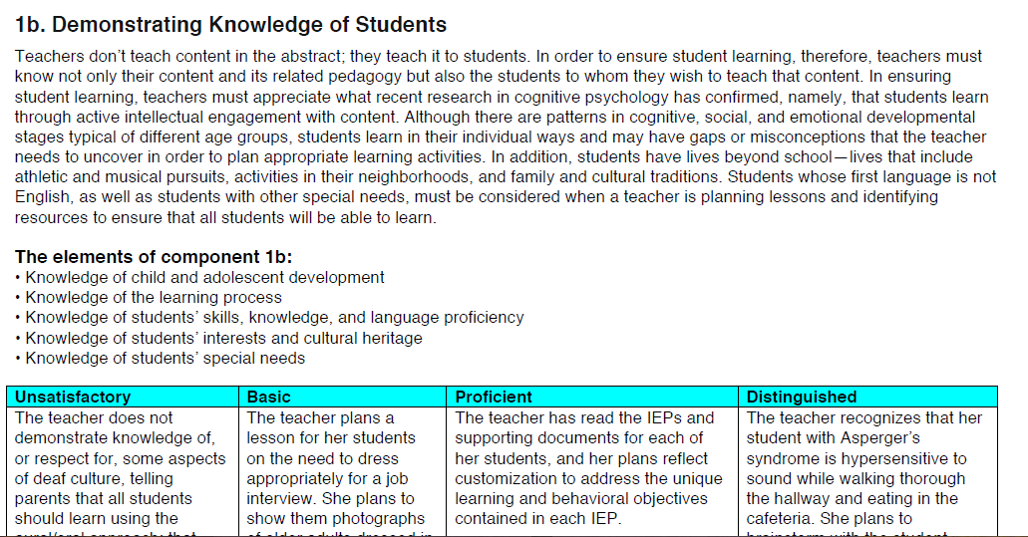
Understanding Domains 1 and 4
Component description and elements remain the same
LOP are specific to SPED

Slide 41
Use the 2013 Charlotte Danielson Framework for the Following Slides…

Slide 42
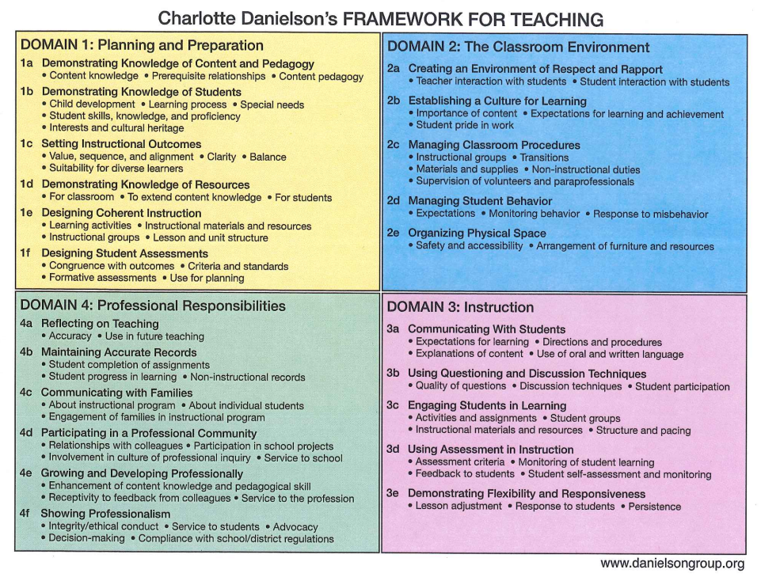
Charlotte Danielson's Framework for Teaching

Slide 43
Unpack 1b
Skim the narrative and the elements.
2. Read all 4 levels of performance silently.
3. What makes each level of performance different
from the previous level?

Slide 44
Unpack 2c
Choose a disability you wish to study.
1. Skim the narrative and read all 4 levels of performance silently.
2. What makes each level of performance different from the previous level?
3. How would using the LOP guide your conversations with your current evaluator?
4. What do you currently do in your practice that is related to this component?
Where does your practice fall in the LOP?

Slide 45
Considerations…
How do the levels of performance support special education? What might be added? What might be deleted?
How might understanding these scenarios help you to improve your practice?
How might understanding these scenarios better support the conversations between you and your colleagues and you and your evaluator(s)?

Slide 46
Unpack 3c
Choose a disability you wish to study.
Skim the narrative and read all 4 levels of performance silently.
2. What makes each level of performance different from the previous level?
3. How would using the LOP guide your conversations with your current evaluator?
4. What do you currently do in your practice that is related to this component?
Where does your practice fall in the LOP?

Slide 47
Considerations…
How do the levels of performance support special education? What might be added? What might be deleted?
How might understanding these scenarios help you to improve your practice?
How might understanding these scenarios better support the conversations between you and your colleagues and you and your evaluator(s)?
What might be your next steps to continue exploring and sharing the Scenarios?

Slide 48
Identifying Artifacts
Notes:
Now that you’ve had a better look at the Framework for Teaching, let’s take a look at the artifacts that could be used for different domains.

Slide 49
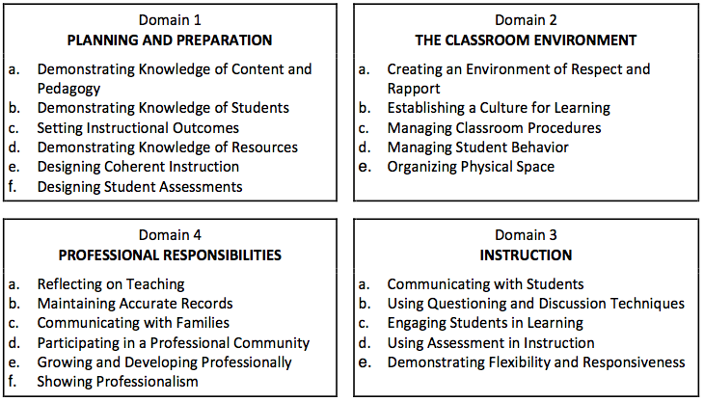
Domains
Notes:
Reminder of the 4 domains and components of each
Taken from the Teacher Effectiveness Handbook

Slide 50
Evidence Sources: Observation and Artifacts
(This is the recommended model)
Notes:
1 and 4 – artifact domains
2 and 3 – observable domains

Slide 51
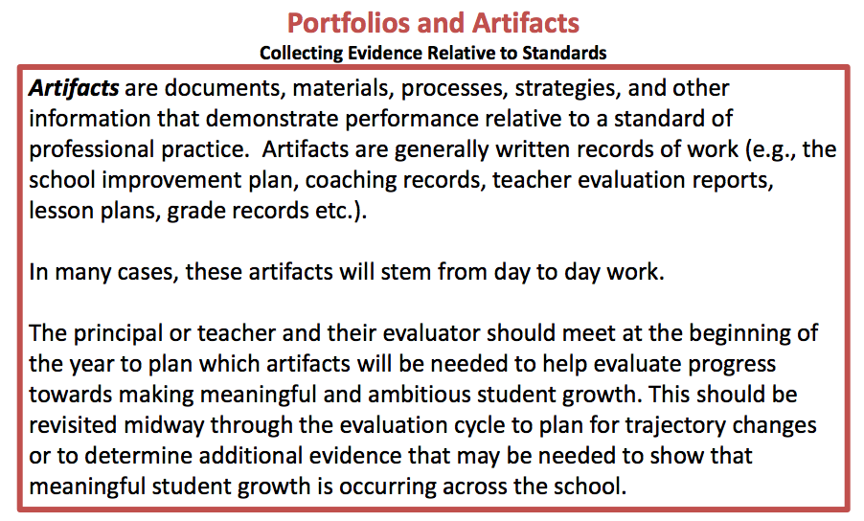
Portfolios and Artifacts
Notes:
Pictures, flyers, communication logs, emails, video clips, etc…
When in doubt, KEEP IT!

Slide 52
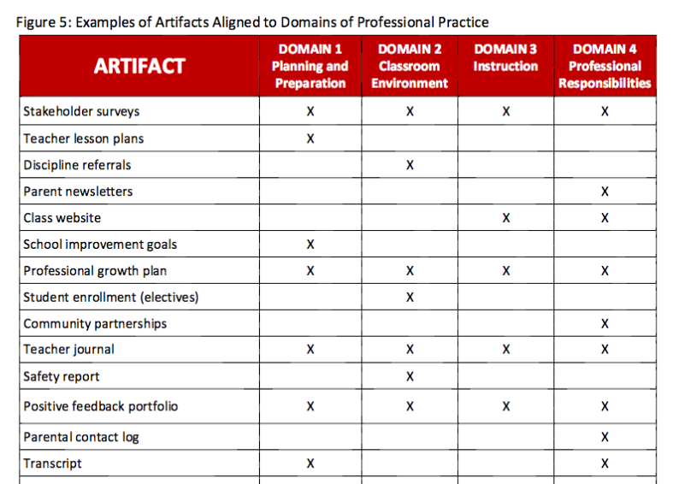
Portfolios and Artifacts
Notes:
Even thought 2 and 3 are considered “observable domains” you can still submit artifacts demonstrating those components
Hand out second artifact sheet – taken from TE handbook

Slide 53
THANK YOU!

