Slide 1
South Dakota Principal Effectiveness Model
PE Webinar V
2/02/2023

Slide 2
Domain Five
School and Community Relationships
Notes:
Summary of Domain 5: According to the PE Handbook, effective principals/assistant principals create a culture of collaboration among the school, families, and communities by creating an inviting environment that helps parents and community members feel welcome and comfortable in the school and by ensuring that parent and community member contributions are acknowledged and valued.
One of the most effective tools for assessing the degree to which a school is successful in achieving a culture of collaboration and an inviting environment for both families and community members is to work with the South Dakota Parent Information and Resource Center (SDPIRC) to conduct a Family Friendly Walk Through. I have attached a link that will connect you to the SDPIRC where you can learn more about the Family Friendly Walk Through Process and how valuable the feedback is. The SDPIRC also offers multiple other resources for both schools and families.

Slide 3
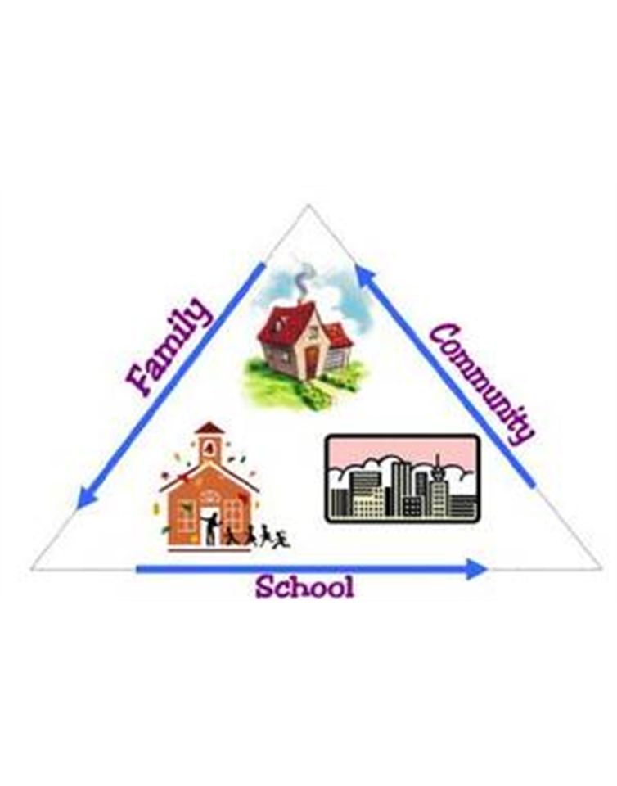
Culture of Family/Community Collaborations and Involvement
Domain 5.1
Notes:
The South Dakota Principal Effectiveness Model defines a principal's actions related to Component 5.1 as follows:
An effective principal supports and promotes a culture of family and community involvement to engage stakeholders in school goals and programs.

Slide 4
Culture of Family/Community Collaborations and Involvement Considerations
How do you make families and caregivers feel welcome in your school?
How do you appropriately involve families in setting goals and making decisions about the school?
If you gather input from families, how do they know their input has been heard and valued?
How do you provide opportunities for families to support school success?
How do you assess the effectiveness of family/community partnerships?
How do you help stakeholders connect the value of education to post-secondary success and community vitality?
Notes:
Here are some questions for consideration and reflection.

Slide 5
Culture of Family/Community Collaborations and Involvement Level Comparison and Progression
Helps families feel welcome via an inviting environment and opportunities for involvement.
Works with families to identify barriers to involvement.
Works with family reps to provide input to decisions about school goals.
Acknowledges family/community member contributions.
Creates multiple opportunities for meaningful involvement.
Works with families/staff to implement strategies to address barriers to involvement.
Works with families and community to provide input to decisions about school goals and program.
Acknowledges family/community contributions and ensures family/community members feel values.
Actively monitors family/community involvement and adjusts as needed to create new opportunities for involvement.
Communicates the value of education to postsecondary success and community vitality and engages families/community members in conveying the same message to others.
Principal routinely monitors effectiveness of family/community member involvement.
Engages family/community members in improving effectiveness of partnerships.
Notes:
According to Epstein, Sanders, Sheldon, & al., 2009, effective principals/assistant principals recognize that involving family and the community in the education of their students has an impact on student achievement, retention rates, staff morale, and improved use of resources). These principals ensure that all families are welcome and that barriers to involvement have been addressed. They also create partnerships to engage stakeholders in establishing and supporting school goals and programs. Using multiple communication strategies, principals help stakeholders see the value of education for postsecondary success and community vitality. At the distinguished level, an effective principal monitors and adjusts the involvement as needed to continually meet student needs and ensure that parents/guardians and community member contributions are acknowledged.
As you reflect upon the progression of the rubrics, you can see how a principal’s practice at the basic level moves from working with and helping families to become involved to actually creating multiple opportunities for meaningful involvement at the proficient level. At the highest level of practice, the principal monitors the success of involvement and adjusts accordingly.

Slide 6
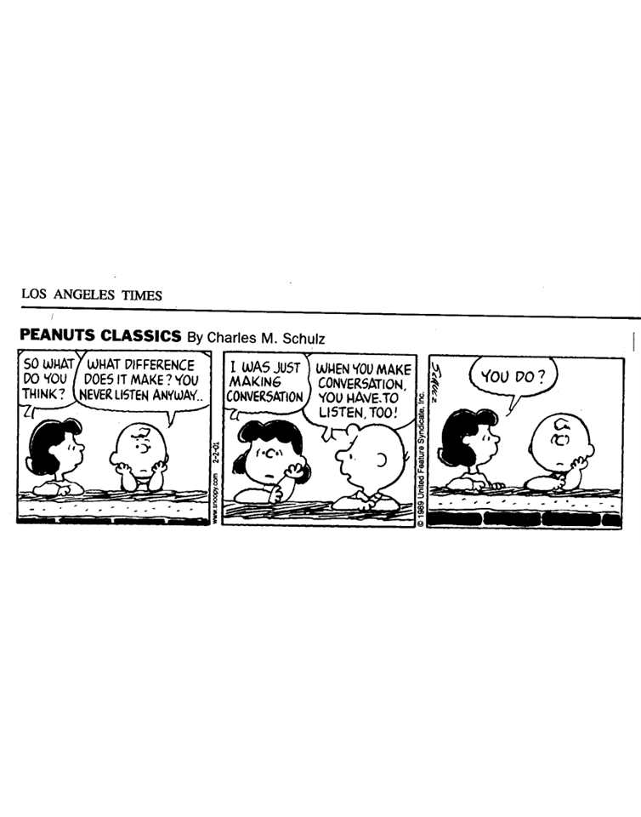
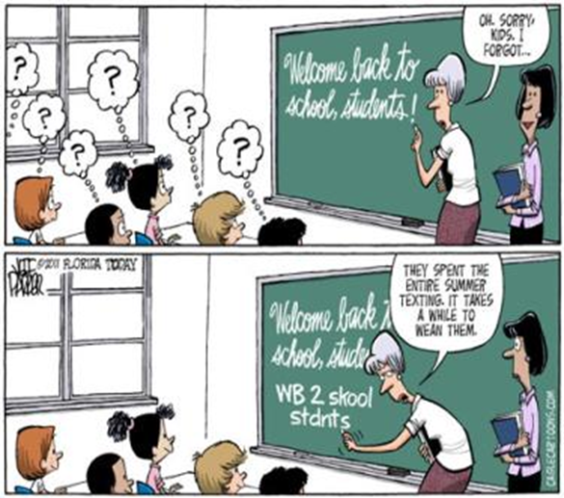
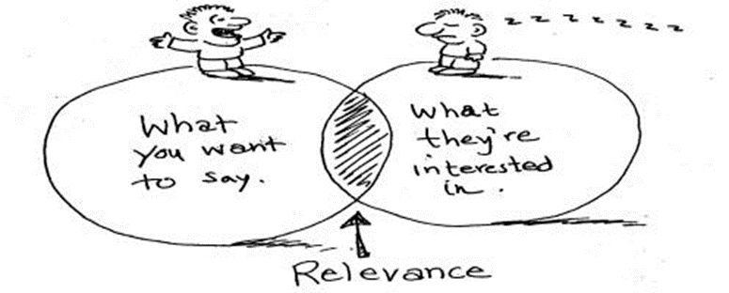
Two Way Communication with Internal and External Audiences
Domain 5.2
Notes:
The South Dakota Principal Effectiveness Model defines a principal's actions related to Component 5.2 as follows:
An effective principal uses multiple methods to frequently and clearly communicate to and seek input from parents, staff, and community members.
I think all three cartoons speak to just a few of the challenges we face related to effective communication with our stakeholders:
1. The challenge of “how well do we really listen to our stakeholders?”
2. The challenge of utilizing multiple methods of communication and knowing which method is appropriate for the message.
3. And, finally the challenge of achieving relevance with our stakeholders. Is the information we send the information they are interested in?

Slide 7
Two Way Communication with Internal and External Audiences Considerations
What are the ways in which you communicate with staff, students, families, and communities?
How have you taken into consideration the demographics of your school when communicating with stakeholders?
If you are gathering input from stakeholders, how have you used the input in your decision making?
Do you communicate with stakeholders about how you have used their input in decision making? If so, how?
Have you considered the role of students as stakeholders? If so, how? The Danielson Model frequently addresses students becoming leaders of their own learning. How do you involve students in decision making and leadership in the school at large?
Notes:
Here are some questions for consideration and reflection.

Slide 8
Two Way Communication with Internal and External Audiences Level Comparison and Progression
Communicates frequently with parents and staff using multiple methods of communication.
Provides stakeholders with multiple methods to communicate with the school.
Communicates in a clear and understandable manner.
Utilizes some of the information provided by stakeholders.
Builds effective two-way communication systems between stakeholders and the school utilizing multiple accessible methods.
Skillfully and clearly communicates information tailored to the audience.
Considers all information provided by stakeholders when making decisions.
Moves beyond typical communication practices to develop relationships via home visits, technology, and visiting community groups.
Creates and promotes opportunities for stakeholders to share their experiences and viewpoints, i.e. focus groups, open forums, surveys, etc.
Tracks the impact of interactions with stakeholders by revising and expanding the scope of communications.
Monitors and tracks the success of different communication approaches.
Conveys information about how input was used in making decisions.
Notes:
As described in the Recommended Model, effective principals/assistant principals establish, maintain, and utilize multiple communication systems for students, parents, staff, and community members so that all stakeholders have access to information about the school and can communicate with the school easily and effectively. Effective principals also use a variety of communication methods tailored to the intended audience and monitors to ensure that the methods are effective. In addition, principals ensure that the communication is frequent, clear, and easily understood and provide useful information to the intended audiences. Effective principals acknowledge incoming information and utilize the information, as appropriate, for decision-making.
As you reflect upon the progression of the rubrics, you can see how a principal’s practice at the basic level moves from one way communication to two way communication at the proficient level. And, at the distinguished level, the principal not only assesses the effectiveness of communication but also shares with stakeholders how input was used in decision making.

Slide 9
Culture of Dignity, Fairness, and Respect
Domain 5.3
Maya Angelou
Notes:
This quotes seems to sum up what this component is all about:

Slide 10
Culture of Dignity, Fairness, and Respect Considerations
How do you develop the capacity of both your staff and students to treat all people equitably and with respect?
How have you and your staff engaged in courageous conversations about diversity and culture and how they impact student learning?
Notes:
There are really only a couple of questions to be asked related to this component.

Slide 11
Culture of Dignity, Fairness, and Respect Level Comparison and Progression
Occasionally models professionalism.
Occasionally holds students and colleagues to professional, ethical, and respectful behavioral expectations.
Actively seeks opportunities to engage in courteous conversations about diversity and culture.
Models professional, ethical, and respectful behavior at all times.
Expects students and colleagues to display professional, ethical, and respectful behavior at all times.
Builds the collective capacity of the school and the community by initiating direct conversations about culture and diversity and how they impact learning.
Articulates and communicates appropriate behavior to all stakeholders, including parents and community.
Creates mechanisms, systems, and/or incentives to motivate students and colleagues to display professional, ethical, and respectful behavior at all times.
Develops structures, outreach and training to ensure that staff develop the skill set to treat all people equitably and with respect.
Develops staff capacity to engage in courageous conversations about diversity and culture – and how they impact student learning.
Notes:
According to the Principal Effectiveness Model, effective principals/assistant principals model respectful behavior and hold teachers, other staff, and students to this high standard by taking appropriate action to reinforce respectful behavior when necessary. Effective principals take swift appropriate actions when inappropriate conduct is reported or observed. Effective principals build school and community capacity for dignity, fairness, and respect by initiating direct conversations about culture and diversity and how they impact learning.
As you reflect upon the progression of the rubrics, you can see how a principal’s practice at the proficient level moves from modeling professional, ethical, and respectful behavior at all times to developing structures, outreach and training to build the capacity of staff, students and stakeholders at the distinguished level.
I would also pose a new question at this point. Should an individual who only occasionally models professionalism ever be in a leadership position in our schools?

Slide 12
Active Involvement with the Community
Domain 5.4
Notes:
An effective principal exhibits high visibility and active involvement within the school and community.

Slide 13
Active Involvement with the Community Considerations
Do you have a strategic plan for developing partnerships with community organizations, community members, and businesses? If so, how do you evaluate the success of the plan?
How do you develop and nurture collegial working relationships within the school community?
How do you perceive yourself as an effective leader within both the internal and external school community?
How would assess and/or evaluate your role as an effective leader within both the internal and external school community?

Slide 14
Active Involvement with the Community Level Comparison and Progression
Actively participates in district meetings, district-wide projects.
Supports the district mission, vision, and strategic plan.
Demonstrates timely communication with colleagues.
Engages some community organizations, community members, and/or businesses in annual school events.
Actively participates in district meetings, district-wide projects.
Supports the district mission, vision, and strategic plan.
Demonstrates timely communication with colleagues.
Proactively volunteers to participate and support district wide projects.
Establishes ongoing positive relationships with community organizations/members to maximize community contributions to the school
Establishes strategic partnerships with community organizations/members.
Increases the types and numbers of organizations with whom the school partners.
Promotes and enhances collegial working relationships through timely communications, mentoring, sharing best practices, and volunteering for projects to support colleagues.
Is well known and highly regarded by internal and external stakeholders as an effective leader.
Notes:
As you reflect upon the graphic, you can see the continuum of principal behaviors from the basic level to the distinguished level. An effective principals/assistant principals manage and maintain positive relationships with all individuals within the school and the community. They are also active and visible within the district and the community. Effective principals are engaged and active participants in district meetings, participate in district-wide projects when asked, support the district mission, vision, and strategic plan, and demonstrate open and timely communication with colleagues. Effective principals establish connections with the community that align and support accomplishment of the school vision and goals. In addition, effective principals are recognized by community members as effective leaders.

Slide 15
Ethical and Cultural Leadership Domain 6
Notes:
Summary of Domain 6: According to (Davis & Donald, 1997), cultural proficiency is a system requiring the integration and transformation of knowledge about individuals and groups of people into specific standards, policies, practices, values, and attitudes used in appropriate cultural settings to increase the effectiveness and quality of services, thereby producing better outcomes. Effective leaders should try to incorporate cultural leadership into all aspects of their work and interactions with stakeholders. Effective principals are also models of ethical behavior and follow the South Dakota Code of Ethics for Professional Administrators.

Slide 16
Sensitivity to Diversity and Cultural Differences
Domain 6.1
Notes:
An effective principal expresses appreciation for and sensitivity to diversity and cultural differences.

Slide 17
Sensitivity to Diversity and Cultural Differences Considerations
How have you assessed the needs of the school community related to culture and diversity?
What staff development and programs have you developed and/or facilitated to meet those needs?
Is the implementation of culturally responsive instruction sporadic, i.e. a unit here and there, or, is there a systemic implementation of culturally responsive instruction?
How does culturally responsive instruction fit into the expectation of a guaranteed and viable curriculum?
What student and staff behaviors are evident in your school that demonstrate and understanding of and respect for diversity among peers?
How do you seek and utilize community resources to strengthen an understanding of and respect for cultural diversity?

Slide 18
Sensitivity to Diversity and Cultural Differences Level Comparison and Progression
Understands the diversity of the school community and recognizes diversity a an asset to the school.
Articulates the need for all school staff and students to develop cultural understanding and competence.
Utilizes a variety of methods and resources to demonstrate an appreciation and understanding of the community’s cultural diversity within the school.
Demonstrates personal comfort talking about diversity and culture.
Understands and demonstrates an appreciation for and sensitivity to diversity in the school community and recognizes that diversity is an asset to the school.
Provides professional development for school staff to develop cultural understanding and competence.
Collaborates with the community to utilize a variety of methods and resources to demonstrate an appreciation and understanding of the community’s cultural diversity within the school.
Monitors school staff cultural competence and fosters the implementation of culturally responsive instruction.
Within the school, the students accept and respect students who are different than they are and expect their peers to value diversity.
Secures external resources to expand the school’s appreciation of the community’s diverse cultural, social, and intellectual resources.
Recognizes and integrates the learning opportunities that come from a diverse community.
Consistently solicits feedback to ensure that all cultural groups feel respected and valued and immediately addresses any area of concern.
Notes:
In this standard at the very basic level, the principal demonstrates an understanding and appreciation of the diversity of the school culture. At the proficient level, the principal not only understands and demonstrates an appreciation for a diverse culture but also provides professional development to foster culturally responsive instruction. At the distinguished level, we see an expectation for students to accept and respect diversity. And, as always, at the distinguished level, the principal seeks feedback from the community to assess and monitor effectiveness.

Slide 19
Modeling Values, Beliefs, and Attitudes (6.2) South Dakota Code of Ethics (6.3)
“The first principle of ethical power is Purpose. By purpose, I do not mean your objective or intention-something toward which you are always striving. Purpose is something bigger. It is the picture you have of yourself-the kind of person you want to be or the kind of life you want to lead.”
Ken Blanchard
Notes:
An effective principal displays values, beliefs, and attitudes that inspire others to higher levels of performance and complies with the South Dakota Code of Professional Ethics.
The quote above and the following rubrics in the next slide speak for themselves.

Slide 20
Modeling Values, Beliefs, and Attitudes Level Comparison and Progression
Serves as a role model who exemplifies high expectations for performance and other values articulated in the school mission and vision.
Is supportive, kind, and open.
Verbalizes a belief in students and tries to inspire students to work hard and learn.
Serves as a role model who exemplifies high expectations for performance, lifelong learning, and other values and beliefs that the school articulates within its mission, vision, culture, values, and expectations.
Is supportive, kind, and open and shows optimism for the future.
Is a passionate advocate for the school.
Symbolizes a belief in students through statements and actions, and inspires students to work hard and learn.
Is widely viewed as an effective role model and inspiration to students.
Is a passionate advocate for learning and continuous improvement and for education as the pathway to success.
Inspires teachers and students to achieve their personal best.

Slide 21
South Dakota Code of Ethics Level Comparison and Progression
The principal is aware of and consistently follows all of the provisions of the South Dakota Code of Ethics for Professional Administrators and Teachers
The principal holds all teachers accountable for following the provisions of the South Dakota Code of Ethics for Teachers.
The principal collects feedback on the extent to which he/she is viewed as aligning practices with the provisions of the South Dakota Code of Ethics for Professional Administrators and The South Dakota Code of Ethics for Teachers and makes corrections as needed.

Slide 22
Domain 5-6 Sample Artifact List
Stakeholder surveys
Formative reviews
Minutes of planning sessions
Progress on school improvement plan
School/staff meeting agendas
Curriculum maps aligned to domains
Documentation of instructional practices used in the school
Community partnerships and their outcomes
Teacher professional growth plans
Community partnerships and their outcomes

Slide 23
Domain 5-6 Sample Artifact List
Estimated community resources leveraged by the school
Public services supported by the school
Communication logs and other feedback
Parent newsletters
Parent organization/association rosters
Family engagement in school-based activities
School web-site
Mentoring/Internship
Principal professional growth plan
Media Relations

Slide 24
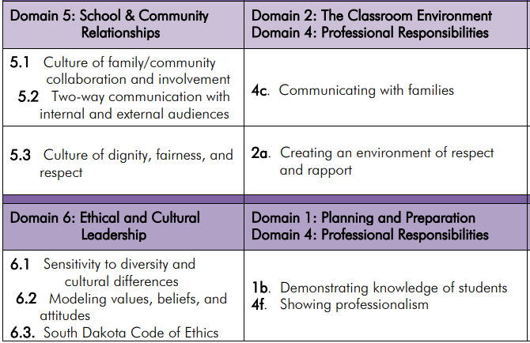
Doman 5-6 PE to TE Crosswalk
Notes:
In the Power Point you received via email, there is an extra slide titled Domain 3. You may keep the slide in as a point of reference or simply delete the slide.

Slide 25
Principal Effectiveness Comparison to Turnaround Principles
https://doe.sd.gov/Effectiveness/documents/PE-turnaround.pdf

Slide 26
Principal Effectiveness Tools
https://doe.sd.gov/Effectiveness/Principal.aspx

