Slide 1

Perkins Budget Application
Training
Questions? Contact Kim.Roth@state.sd.us or your Regional Specialists

Slide 2
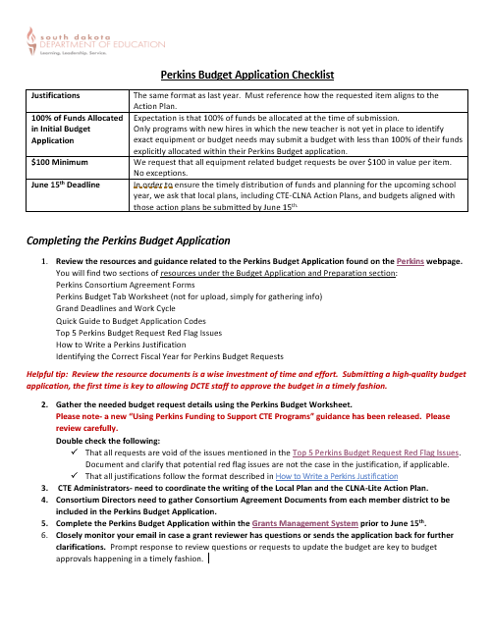
Instructions
Goal-
To submit a high quality budget application the first time, prior to the June 15th deadline!

Slide 3
Key Updates:
New Guidance Document! | A newly revised “Using Perkins Funds to Support CTE Programs” guidance document is now available! Find it Here!
Justifications | See instructions here. Be sure to reference how each request supports the Action Plan.
100% of funds Allocated in Initial Budget Application | Expectation is that 100% of funds be allocated at the time of submission. Only programs with new hires in which the new teacher is not yet in place to identify exact equipment or budget needs may submit a budget with less than 100% of their funds explicitly allocated within their Perkins Budget application.
$100 Minimum | We request that all equipment related budget requests be over $100 in value per item. No exceptions.
One Item Per Line. | Please do not clump or group lower cost equipment items into ‘kits’ to meet the $100 per item threshold.
June 15th Deadline | Late applications will be reviewed last and may necessitate a monitoring visit to determine how the consortium/entity can make steps towards better managing their grant dollars.

Slide 4
Learn
Review the new resources and guidance related to the Perkins Budget Application. On the Perkins webpage, under the Perkins V Grant Forms drop down menu, you’ll find new resources related to:
Using Perkins Funds to Support CTE Programs
Perkins Consortium Agreements
Perkins Local Plan Forms (customized for either Single District Entities or Consortiums)
Perkins Grant Work Cycle and Grant Deadlines
Quick Guide to Budget Application Codes
Top 5 Perkins Budget Request Red Flag Issues
Identifying the Correct Fiscal Year for Perkins Budget Requests
How to Write a Perkins Justification
Helpful Tip: Reviewing the new documents is a wise investment of time and effort. Submitting a high-quality budget application, the first time is key to allowing DCTE staff to approve the budget in a timely fashion.

Slide 5
Prepare
1. Gather the needed budget request details using the Perkins Budget Worksheet (here in Budget Preparation and Application) .
Review the “Using Perkins Funds to Support CTE Programs” guidance.
Double check the following:
That all requests are void of the issues mentioned in the Top 5 Perkins Budget Request Red Flag Issues. Document and clarify that potential red flag issues are not the case in the justification if applicable.
That all justifications follow the format described in How to Write a Perkins Justification.
2. CTE Administrators- need to coordinate the writing of the Local Plan
3. Consortium Administrators need to gather Consortium Agreement Documents from each member district to be included in the Perkins Budget Application.

Slide 6
Submit
  3. Complete the Perkins Budget Application within the Grants Management System prior to June 15th.
4. Closely monitor your email in case a grant reviewer has questions or sends the application back for further clarifications. Prompt response to review questions or requests to update the budget are key to budget approvals happening in a timely fashion.

Slide 7
- Log In
- Passwords Issues
- Create an Application

Slide 8
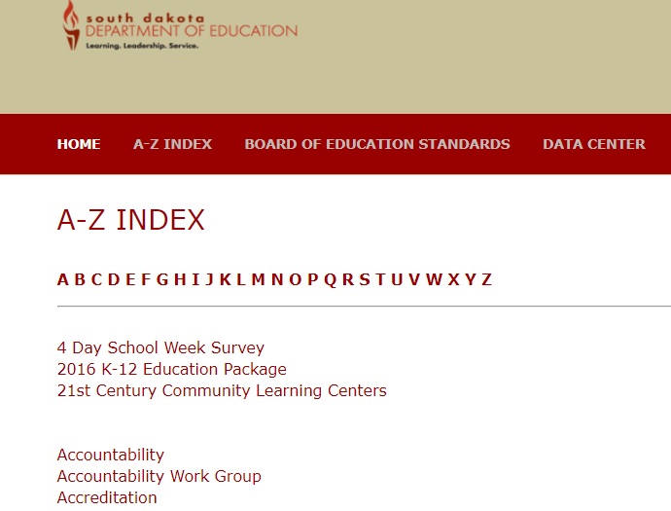
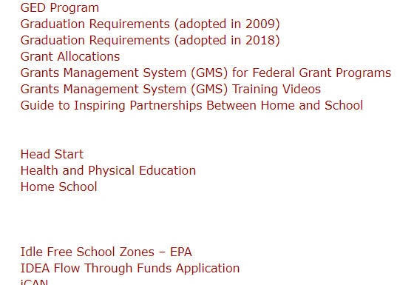

Accessing the Grants Management System
1. Go to the A-Z Index on the SD Department of Ed Website
2. Select ‘G’ for Grants
Then, select…

Slide 9
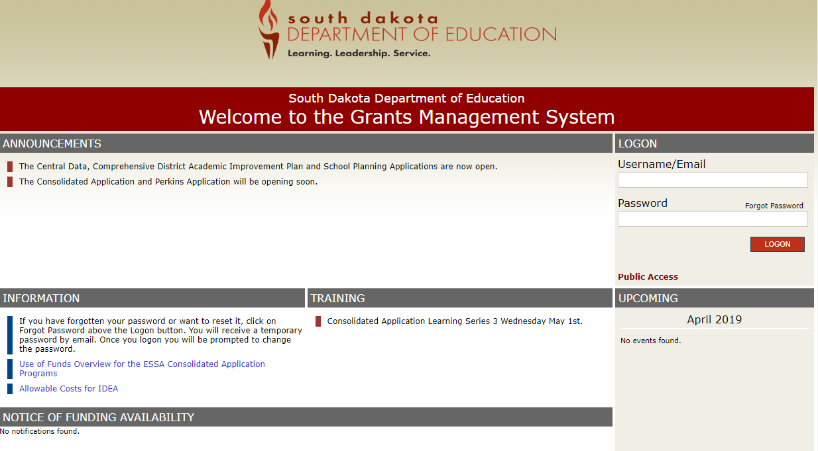
Accessing the Grants Management System (GMS)
Log In
Change password if needed

Slide 10
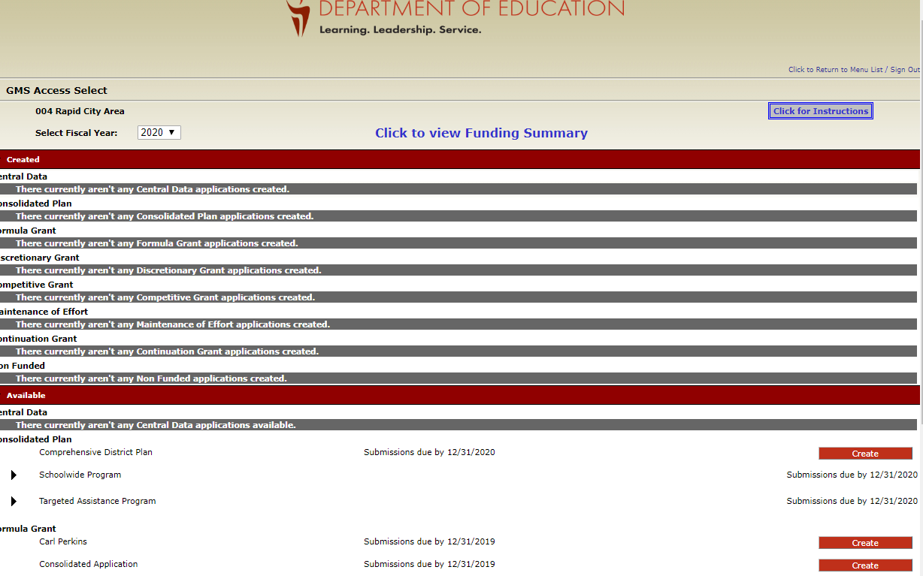
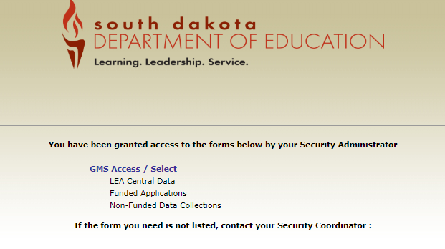
Create an Application
Find ‘Carl Perkins’. Select ‘Create’.
Select: GMS ACCESS/Select

Slide 11
- Contact Information
- Allocation
- Consortium Info
- Program Info

Slide 12
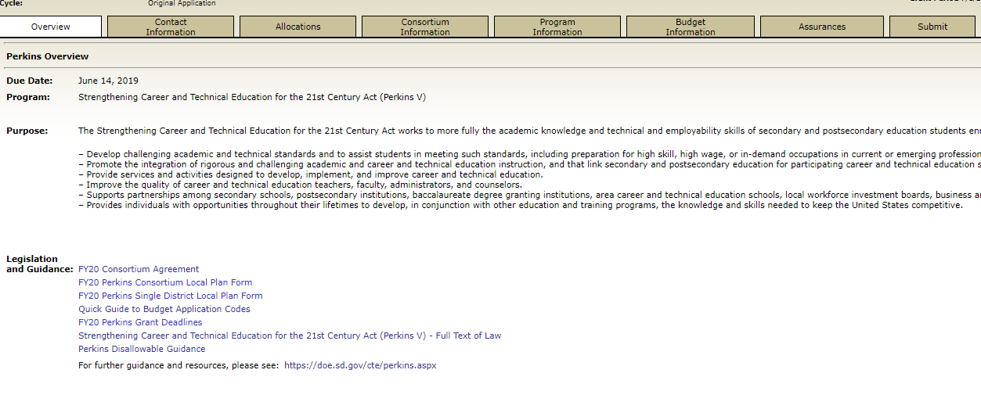
Overview
- General Info
Contact Information Tab
- Comes from Central Data Application (if blank, complete the Central Data Application)
Allocations Tab
- For information purposes

Slide 13
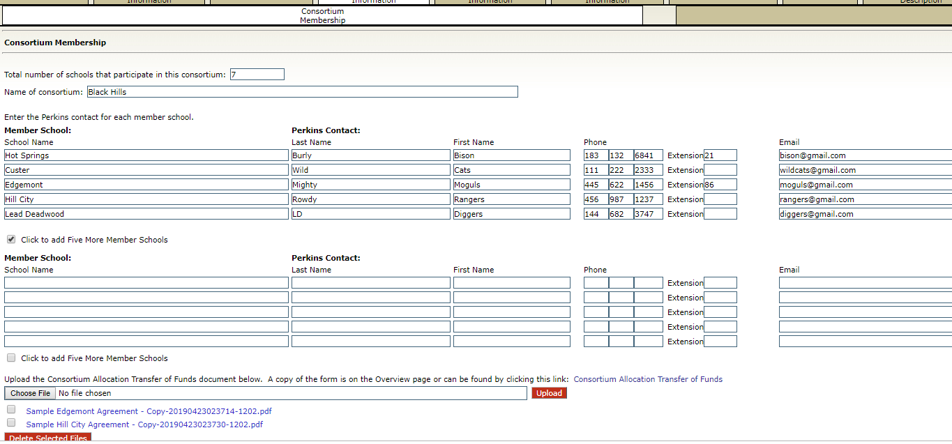



Consortium Membership Tab

Slide 14
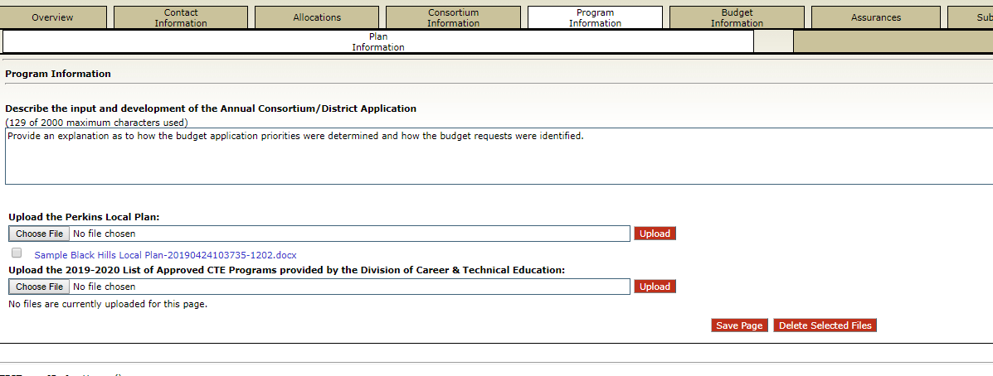
Plan Information Tab
Attach the ‘Approved Programs Letter’ here.
You’ll also upload your Action Plan here for the FY21 budget year.

Slide 15
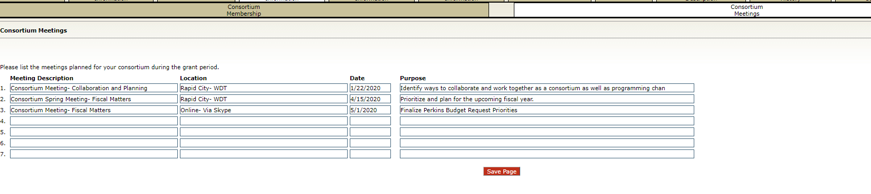
Consortium Meeting Tab

Slide 16
Budget Tab

Slide 17
Key Resources
How to Write a Justification
Quick Guide to Budget Application Codes
Budget Tab Worksheet (Under the Budget Application and Preparation tab)

Slide 18
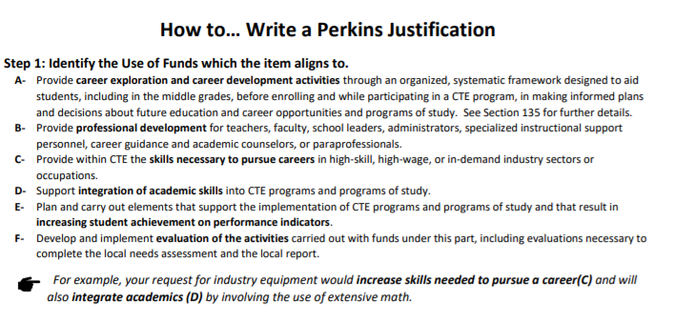
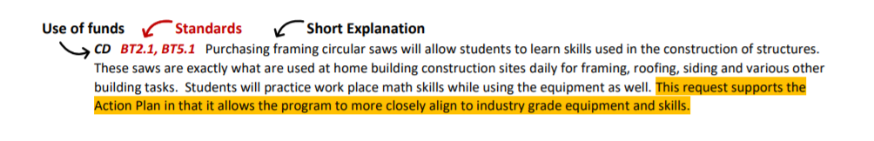
How to Write A Perkins Justification
Step 1: Identify the Use of Funds the request is aligned to.
Step 2: Identify Standards the request is aligned to.
Step 3: Write a short description
Follow the Format!
Link to Document

Slide 19
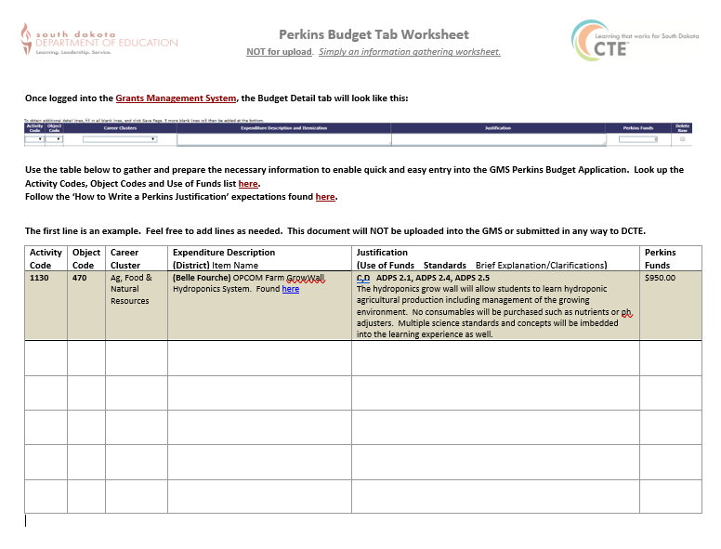
Budget Tab Worksheet
NOT for upload!
Simply a tool designed to help districts/consortia gather the information needed for the budget tab.
Link to Document - Under Budget Application and Preparation

Slide 20
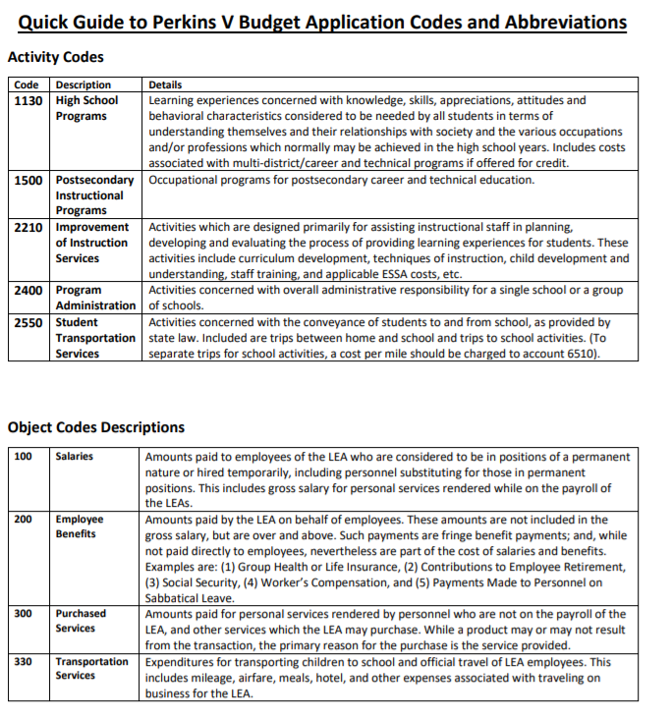
Quick Guide to Perkins Budget Application Codes
Activity Codes
Object Codes
Use of Funds Codes
Link to Document

Slide 21
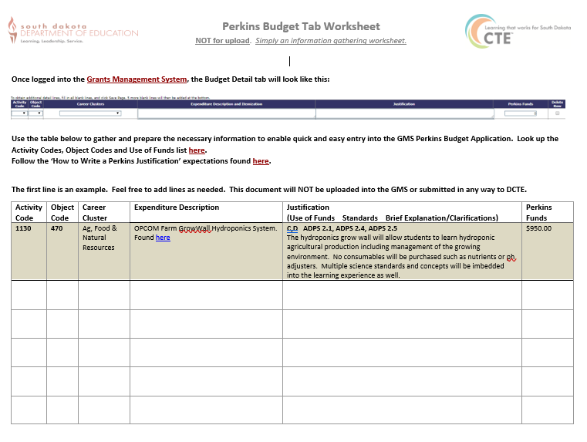

Budget Detail
Tab
#1- Gather Budget Tab worksheets
#2- Self-Check!
Top 5 Perkins Red Flags
How to Write a Perkins Justification

Slide 22
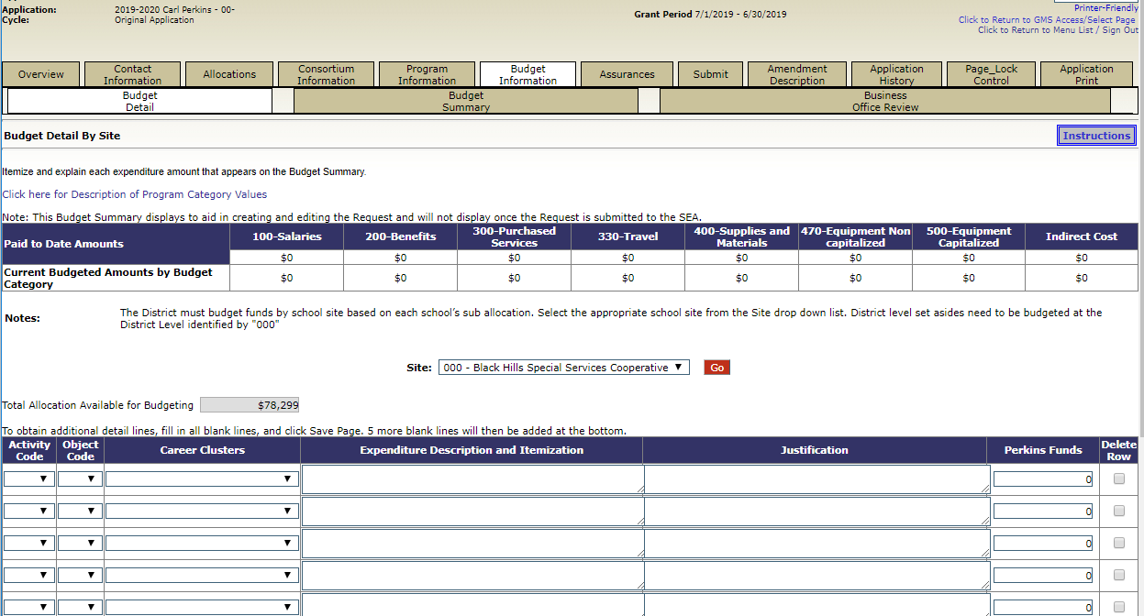
#3- Enter into the GMS Budget Details Tab

Slide 23
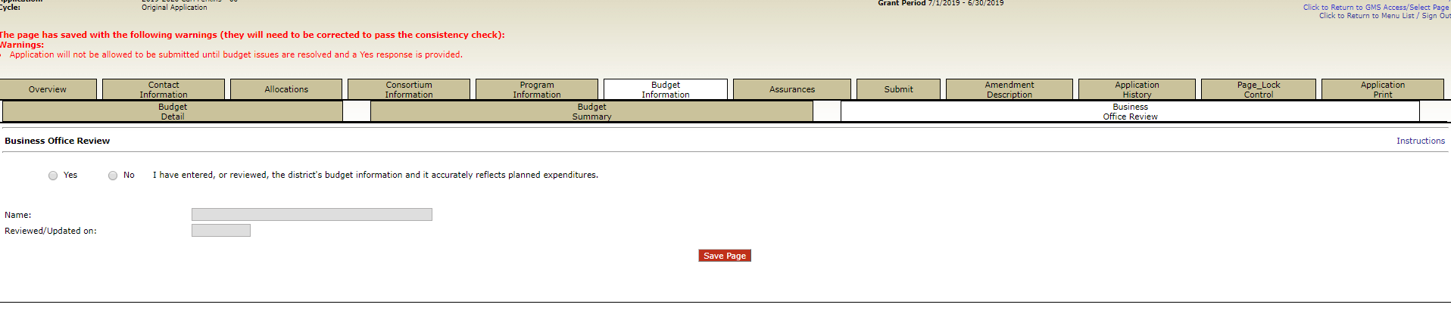
Budget Summary & Business Office Review
The Budget Summary Tab will auto populate for you as you enter budget requests into the Budget Details tab.
Business Office Review Tab- Completed by the fiscal agent’s business manager.

Slide 24
- Assurances
- Submit
- Reviews
Perkins Budget Application Training

Slide 25
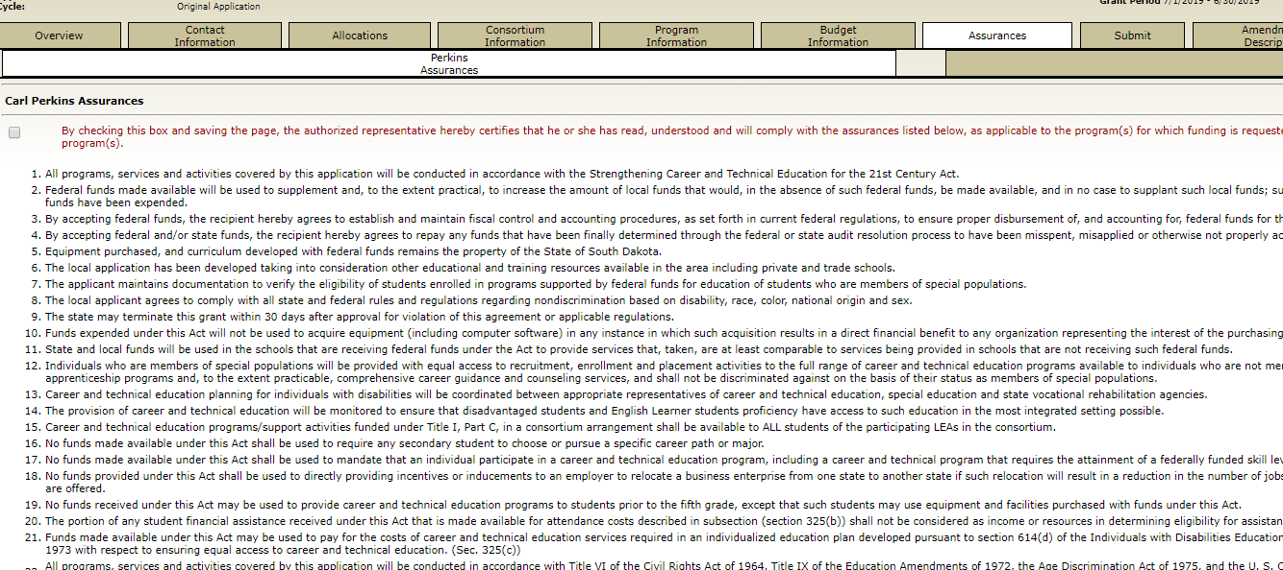
Assurances- Read, Understand, Check if you Agree.

Slide 26
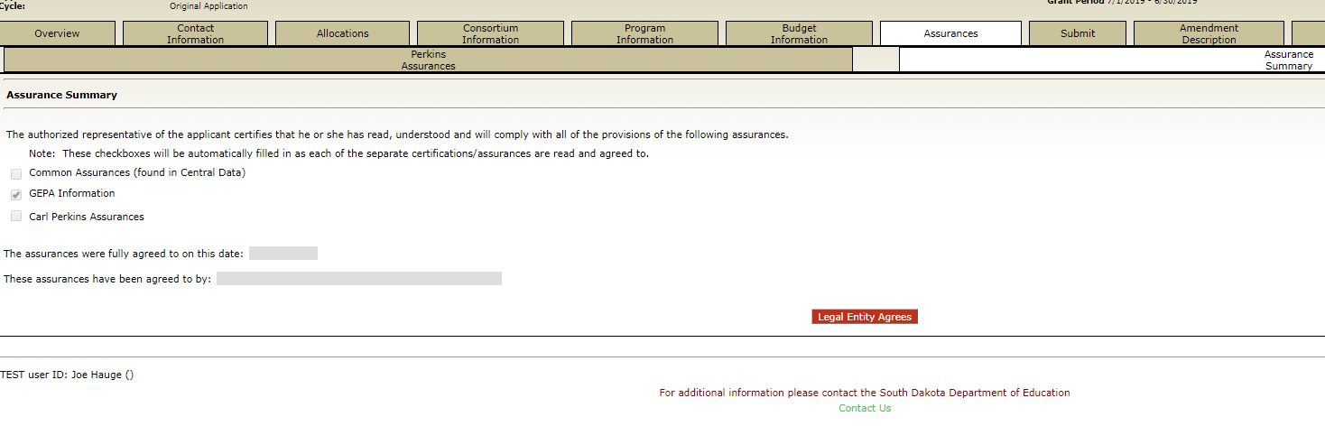
Assurance Summary Tab…Review and Agree

Slide 27
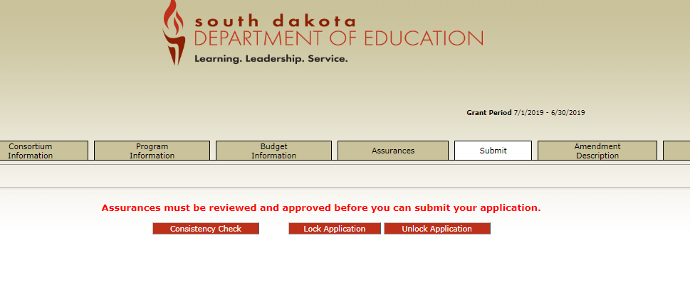


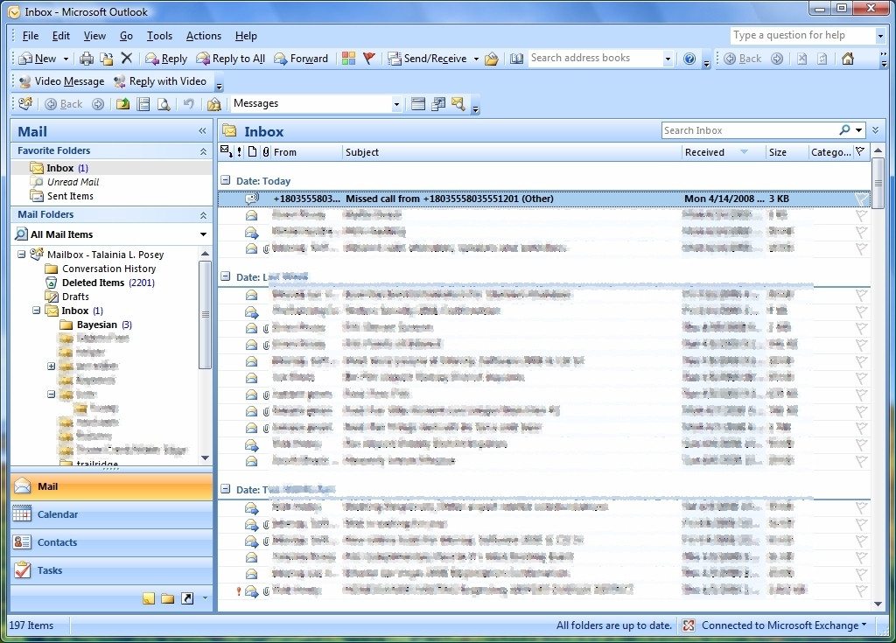
Submit Tab
Run Consistency Check
Fix Errors (if it shows any)
Submit the Application
Celebrate!! You’re Done.
Watch your Inbox…. For follow up questions!

