Slide 1



South Dakota Principal Effectiveness Model
2/02/2023

Slide 2

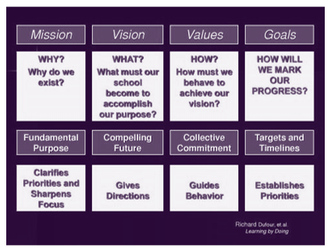
Vision and Goals Domain 1
(DuFour, et al, 2006)
Notes:
The graphic on the right hand side of the slide is from the text, Learning By Doing, by Richard Dufour. The graphic poses some critical questions. The first two deal with how we arrive at our Vision. The second two deal with the values and behaviors upon which we collectively agree. The final question addresses how will we know whether we have achieved our vision.
Have we sat down as a staff of educators and asked ourselves: Why do we exist? And, if we are able to answer that first question, then have we asked ourselves: What must our school become to accomplish our purpose? DuFour also makes reference to a text you are all probably familiar with: Jim Collins book Good to Great. In Good to Great, Collins talks about the hedgehog parable. In this ancient parable, the fox continually tries to outsmart the hedgehog with newer and craftier ideas each day. In contrast the hedgehog is slow with only one trick up his sleeve: rolling up in a ball and playing defense with its sharp quills. “ As basic it seems, the hedgehog’s single-minded game plan always seems to work.” When Collins studied Fortune 500 companies, he learned that the most successful companies came up with a straightforward, compelling vision that drove everything they did. These successful companies did not jump on every new bandwagon that came along. They focused their efforts on a key strategy and stuck to it.
As we move through Components 1.1 and 1.2, I think you will see how the criteria within each component answer the questions posed by DuFour. If you are struggling with the “how” piece of establishing a vision for your school, I would suggest two texts: Learning by Doing, Richard DuFour, et al; and, Building a Professional Learning Community at Work, A Guide to the First Year, Graham and Ferriter. While both of these texts deal with how to successfully implement a professional learning community, even if you aren’t interested in pursuing the route of a PLC, both texts provide valuable insights, strategies, and tools for establishing a vision-not the vision that exists in a three ring binder on a shelf in your office somewhere but a real “living and working” vision that all of your stakeholders understand and support.

Slide 3
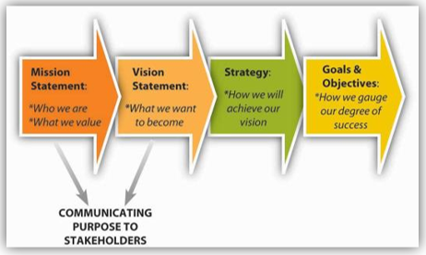
Shared Vision for School and Student Success 1.1
Notes:
The South Dakota Principal Effectiveness Model defines a principal's actions related to Component 1.1 as follows: An effective principal develops and implements goals, objectives, and strategies to achieve a shared vision for school and student success. As you can see in the graphic above, this first component really deals with addressing Who we are and what we want to become?

Slide 4
http://www.solution-tree.com
Notes:
One of the attachments I sent you earlier this week is a survey you might consider administering. The actual document sent to you is a two page survey This is just a snapshot of the the first ten questions dealing with Mission and Vision Setting. Please don’t let the title mislead you. The survey comes from Graham and Ferriter’s text on professional learning communities. However, whether you have PLC’s or not, this is an excellent survey to assess where you are with your mission/vision. Again, establishing effective PLC’s is another discussion altogether. However, this particular survey certainly asks those questions that need to be addressed if you are working on vision/mission or if you think you have an effective vision/mission.
You might be interested in exploring the Solution Tree website. Solution Tree offers many free resources such as this survey.

Slide 5
Shared Vision for School and Student Success Considerations
Does our school have a clear mission statement?
Was our mission statement developed collectively?
Is our mission statement frequently referenced by faculty members in formal and informal meetings?
Have we defined vision statements or guiding principles that describe what our mission should look like in action?
Do we allocate both human and financial resources toward efforts that support our mission?
Notes:
Here are some questions for consideration and reflection. They come directly from the survey I just referenced from the Graham and Ferriter text.

Slide 6
Shared Vision for School and Student Success Considerations
6. Do we make hiring decisions that support our mission?
7. Do our grade level/content level, and/or learning teams have the flexibility/freedom to make decisions when they are aligned with our mission?
8. When faced with decisions that are not aligned with our mission, do we as administrators question the decisions even when the question might be unpopular with our staff?
9. Do community partnerships support our mission?
10. Do we regularly review our mission and vision?
Notes:
Continuation of critical questions.

Slide 7
Shared Vision for School and Student Success
Establishes specific and measurable goals and objectives related to student achievement.
Leads and implement a process for developing a shared vision, strategic goals, and objectives for student achievement that reflect high expectations for students and staff.
Maintains a focus on the vision and strategic goals throughout the school year.
BASIC
Insures actions of teachers and leaders are aligned to the school’s goals, objectives and strategies.
Makes decisions consistent with vision of the school as reflected in SIP.
With stakeholders, creates a vision that inspires action.
Demonstrates (through strategy development) a general understanding of the research on school and instructional effectiveness.
Supports a vision that reflects high expectations for learning and teaching.
Promotes continuous improvement for administrators, staff, and students.
PROFICIENT
Involves stakeholders in a comprehensive diagnosis of school’s strengths and weaknesses using appropriate data and leads a collaborative process to develop annual goals.
Insures a visible vision ingrained in the culture of the organization and routinely used a reference point for decision making
Insures that strategies in the SIP cite specific research that shows high effect sizes and influence on student achievement.
Uses strategic guidelines for decision making to avoid time wasted on unproductive arguments.
Ensures that the school’s identity (vision, mission, goals, objectives, strategies) actually drives decisions and informs the culture of the school.
DISTINGUISHED
Notes:
As you reflect upon the progression of the rubrics, you can see how a principal’s practice at the basic level moves from basic goal setting to the proficient level where the principal with stakeholders aligns all actions and strategies with the vision. At the distinguished level, you see the principal insuring that the chosen strategies are researched based and proven to have an impact on student populations with similar demographics to his/her school. You also see the distinguished principal having developed some guidelines for decision making. We have all been a part of meetings where nothing is accomplished because of the lack of structure for the conversation.

Slide 8
Reviewing and Monitoring for School Improvement
Domain 1.2
“Leadership is about vision. But Leadership is equally about creating a climate where the truth is heard and the brutal facts confronted.”
~Jim Collins in Good to Great
Notes:
Component 1.2 is Reviewing and Monitoring for School Improvement.
Jim Collins really sums this process up with this quote. The question then becomes: How do we create a climate of trust and collaboration where the truth can be heard?

Slide 9
Reviewing and Monitoring for School Improvement Resources, Strategies, Protocols, and Procedures
DuFour, R., DuFour, R., Eaker, R., & Many, T. (2006). Learning by doing: A handbook for professional learning communities at work (pp.19-57 ). Bloomington, IN: Solution Tree Press.
Graham, P., & Ferriter, W. (2010). Building a Professional Learning Community at Work, A Guide to the First Year. Bloomington, IN: Solution Tree Press.
Guskey, Thomas. (2009). The Principal as Assessment Leader.
Peery, Angela. (2011). The Data Teams Experience, A Guide for Effective Meetings (pp. 1-8, 53-59). Englewood, Colorado: The Leadership and Learning Center.
Schmoker, Mike. (2001). The Results Fieldbook, Practical Strategies from Dramatically Improved Schools. (pp. 30-43). Alexandria, VA: Association for Supervision and Curriculum Development.
Schmoker, Mike. (2006). Results Now. (pp. 103-124). Alexandria, VA: Association for Supervision and Curriculum Development.
Notes:
Talking about designing and creating collaborative processes within a climate of trust; and, talking about utilizing data to modify organizational practices, again, within a climate of trust is the first step. But, the design and implementation of these processes and practices is much more complicated and certainly not a topic that can be dealt with in a 30 minute webinar. To that end, I am listing some resources that are worthy of reading because they do provide ideas and examples of processes and procedures for creating a collaborative climate in which educators can use data to inform goal setting and instructional decisions. I know you are very busy and your time is valuable so, in some cases, I have included page numbers of chapters that I think specifically address this topic. You could look at these pages/chapters and then determine if you want to move forward with a study of the entire text. After review, you might consider one of these as a book study topic for your leadership team. The important point here is that you need to establish some kind of process that you use to study and respond to data.

Slide 10
Reviewing and Monitoring for School Improvement Considerations
An External View:
Are there demanding, shared goals which are publicly stated and embraced by all the educators in the building?
Can people articulate the changed they are trying to make and gauge where they are in the process?
Does the organization gather, process, and act on information in order to continuously strive to meet its goals?
Does the organization regularly share information with relevant external sources, such as other schools, community groups, and parent organizations?
Adapted from Brandt, R,. 2003.
Notes:
These four questions deal with how your goals are shared and perceived externally.

Slide 11
Reviewing and Monitoring for School Improvement Considerations
An Internal View:
Does the organization collect and chart/display student achievement data (in a manner that protects and respects student confidentiality)?
Does the organization analyze the data and prioritize needs based upon the data?
Does the organization set, review, and revise incremental SMART goals? (specific, measurable, achievable, relevant, timely)
Does the leadership team/data team/grade level team select common instructional strategies to be employed to address the learning challenges discovered after an analysis of the data?
Do the various internal teams determine results indicators, i.e. When this strategy is implemented, what evidence can we expect to see as evidence of its effectiveness?
Adapted from Perry, 2011
Notes:
These next six questions address internal actions related to monitoring school goals.

Slide 12
Reviewing and Monitoring for School Improvement
Collects and analyzes data for determining the organization’s effectiveness in accomplishing the vision of learning goals in the SIP
Systematically considers new and better ways of leading for improved student achievement and engages stakeholders in the change process.
BASIC
Implements collaborative processes for the collection and analysis of data about the school’s progress for the periodic review and revision of the school's improvement plan.
Collects and analyzes data at least quarterly with school’s leadership team to assess the organization’s effectiveness in accomplishing the vision of learning.
Utilizes data to modify organizational practices and procedures for any goal in which sufficient progress has not been made.
PROFICIENT
Using data, initiates changes to strategies to improve performance, school culture, and other conditions related to school success.
Collects and analyzes data monthly with the school’s leadership team to assess the organization’s effectiveness in accomplishing the vision of learning and school goals.
Collects data to examine fidelity to strategies in the school improvement plan.
Communicates school-wide goals and actions frequently with all appropriate stakeholders.
DISTINGUISHED
Notes:
In the comparison/progression above you can see the principal moving from just collecting data to using data to initiate changes in performance, school culture and other conditions related to school success. At the distinguished level a principal collects and analyzes data monthly with the school’s leadership team. This principal also monitors fidelity to the strategies.

Slide 13
Domain 1
Sample Artifact List
    School vision and mission statements
    School goals
    Progress on school goals
    Stakeholder surveys (parents, teachers, students, community)
    School improvement plans
    Minutes/Agendas of planning sessions
    Progress on school improvement plans
    School/Staff meeting agendas
    Goal setting statements
    SLO’s
    Data notebooks/Data retreats
    Staffing plans
    Schedules/Agendas of PLC’s
    Changes in curriculum and instruction based upon data

Slide 14
Domain 1
Sample Artifact List
    Documentation of instructional practices used in the school
    Teachers’ professional learning opportunities aligned to mission/vision/goals
    Hiring processes/procedures aligned to mission/vision
    School budget aligned to mission/vision
    Teacher professional growth plans aligned to mission/vision/goals
    Community partnerships aligned to mission/vision
    Parent and student handbooks
    Parent newsletters clearly articulating the mission/vision
    Family engagement in school-based activities aligned to mission/vision
    School web-site
    Principal professional growth plan aligned to mission/vision

Slide 15
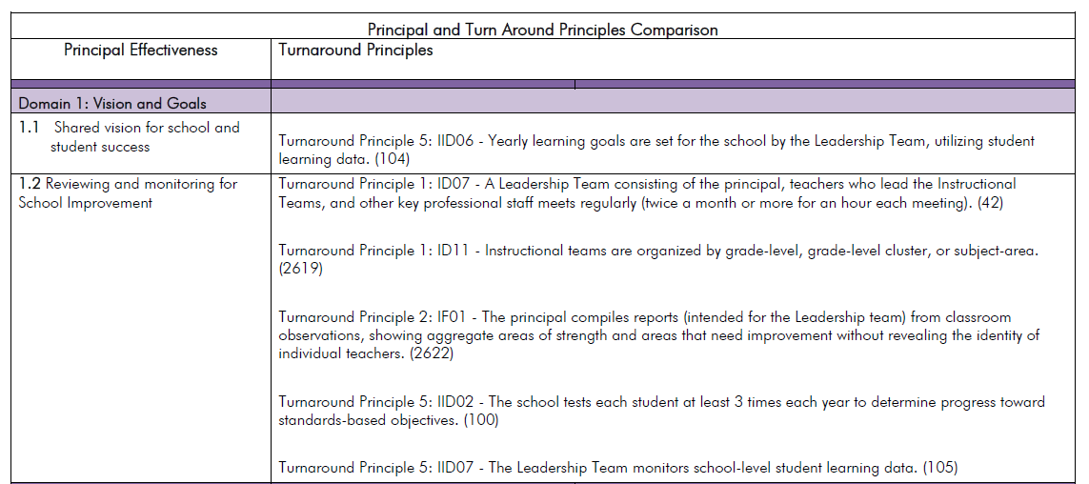
PE to TE Crosswalk

Slide 16
Learning Forward: Innovation Configuration Maps for Standards of Professional Learning: School-Based Roles (2012).
Notes:
One of my concerns with the webinars has been the lack of time to interact and reflect with participants. Dr. Debi Caskey, Asst. Superintendent from the Douglas School District was gracious enough to spend some time with me recently and provided some excellent feedback and suggestions. She suggested that while we might not have the time during the webinar for reflection and interaction, teams of administrators might have a time at a later date to collaborate. She suggested some type of Reflection/Discussion Guide. Cher Daniel, Rapid Valley Elementary Principal, provided me with ideas from Learning Forward: Innovation Configuration Maps for Standards of Professional Learning: School-Based Roles (2012). What you see above is just a snapshot from the Progress Monitoring/Discussion guide for Domain 1. What the Configuration Map helps us do is frame the answers to the critical questions in terms of Look Fors related to principal behaviors, teacher behaviors, and student behaviors. For example, when we have a clear mission statement, what might that look like when we observe the principal, the teacher, and the student? My experience has been that we really don’t improve student achievement and/or change the culture unless we see evidence of the learning and the change all the way down to the student level.
You should have received via my email six Discussion Guide documents-one for each of the six domains. I left all six documents in Word format rather than PDF so that you could use them as working documents. Whether you use the documents as a guide for meeting with your local level team or with administrators from other districts, the document could also serve as an artifact.
Thank you, Dr. Caskey and Mrs. Daniel for the constructive feedback, the ideas, and a tool with which to work.

Slide 17

Principal Effectiveness Comparison to Turnaround Principles
https://doe.sd.gov/Effectiveness/documents/PE-turnaround.pdf

Slide 18

Principal Effectiveness Tools
https://doe.sd.gov/Effectiveness/Principal.aspx
Notes:
You would also have received as attachments via email two more down loadable and reproducible documents from Solution Tree. If you scroll to the bottom of the page of each document, you will instructions as to where to go on the Solution Tree website to find the documents in reproducible form. The first document-Types of Data-helps us to define and sort out the many types of data and the appropriate use of that date. The second document-Components of Data Use-helps us sort out and prioritize our data. If we are really going to use data to define and track the success of our mission/vision, then we need to have an understanding of all of many forms of data with which we are bombarded and how to more efficiently use that data.

Slide 19
Other Sources
Brandt, R. (2003). Data teams success stories, volume 1. Englewod, CO: Lead and Learn Press.
Collins, J. (2001). Good to Great: Why some companies make the leap…and others don’t. New York: Harper Collins.

