Slide 1
Personal Learning Plans
FOR ACCREDITATION REVIEW
Kara Schweitzer
SDMyLife and Career Development Specialist
Kara.Schweitzer@state.sd.us
605.280.7501

Slide 2
Topics to Review
The Why
Admin Rules
PLP Contents
FAQs
Examples
Red Flags

Slide 3
The Why
The Personal Learning Plan section of the accreditation process ensures that all South Dakota students are strategically planning for life after high school.

Slide 4
Administrative Rules
24:43:11:01
(The requirement)
24:43:01:01
(The definition)
“All students in grades 9 through 12 must have a personal learning plan. The personal learning plan must document a minimum of 22 units of credit.”
“ ‘Personal learning plan,’ a plan based on a student's skills and interests that identifies the specific coursework a student needs to reach the student's academic and career goals.”

Slide 5
PLP Contents
What is Required?
Every PLP, for all students grades 9-12, must document a minimum of 22 units of credit.
What else is included?
You Decide!

Slide 6
PLP Content Examples
Aspirations
Career, college, & life goals
Talents
Strengths and weaknesses
Achievements
Successes, awards, milestones
Interests
Passions hobbies and interests
Skills
Knowledge and skills the student have or would like to acquire
Academic Plan
Course plan to help achieve goals and meet requirements

Slide 7
Frequently Asked Questions
What grades are required to have a PLP?
9th 10th 11th 12th
What about 8th graders?
Some schools may choose to start PLPs with 8th graders, but it is not required for 8th graders to have PLPs.

Slide 8
Frequently Asked Questions
What formats can be used for PLPs?
SDMyLife/Xello
Course Planner
Microsoft
Word or Excel
Infinite Campus
Multi-Year Academic Planner
Printout
Paper & Pencil
Other
Any other program or format

Slide 9
Frequently Asked Questions
What is the difference between a PLP & a transcript audit?
Personal Learning Plan
Transcript Audit
Contains past, current and
FUTURE courses
Only tracks past and
current courses
Always contains a minimum
of 22 units of credit
Only has the number of credits
a student has earned
Most contain more than just courses/ credits – such as goals, achievements
Typically, only contains
course/credit information

Slide 10
Frequently Asked Questions
What should school districts submit?
3
Completed Personal Learning Plans
3
Different Grade Levels
22
Units of credit
Remove student identification information
Upload as PDF with no punctuation or special characters in file names

Slide 11
PLP Examples

Slide 12
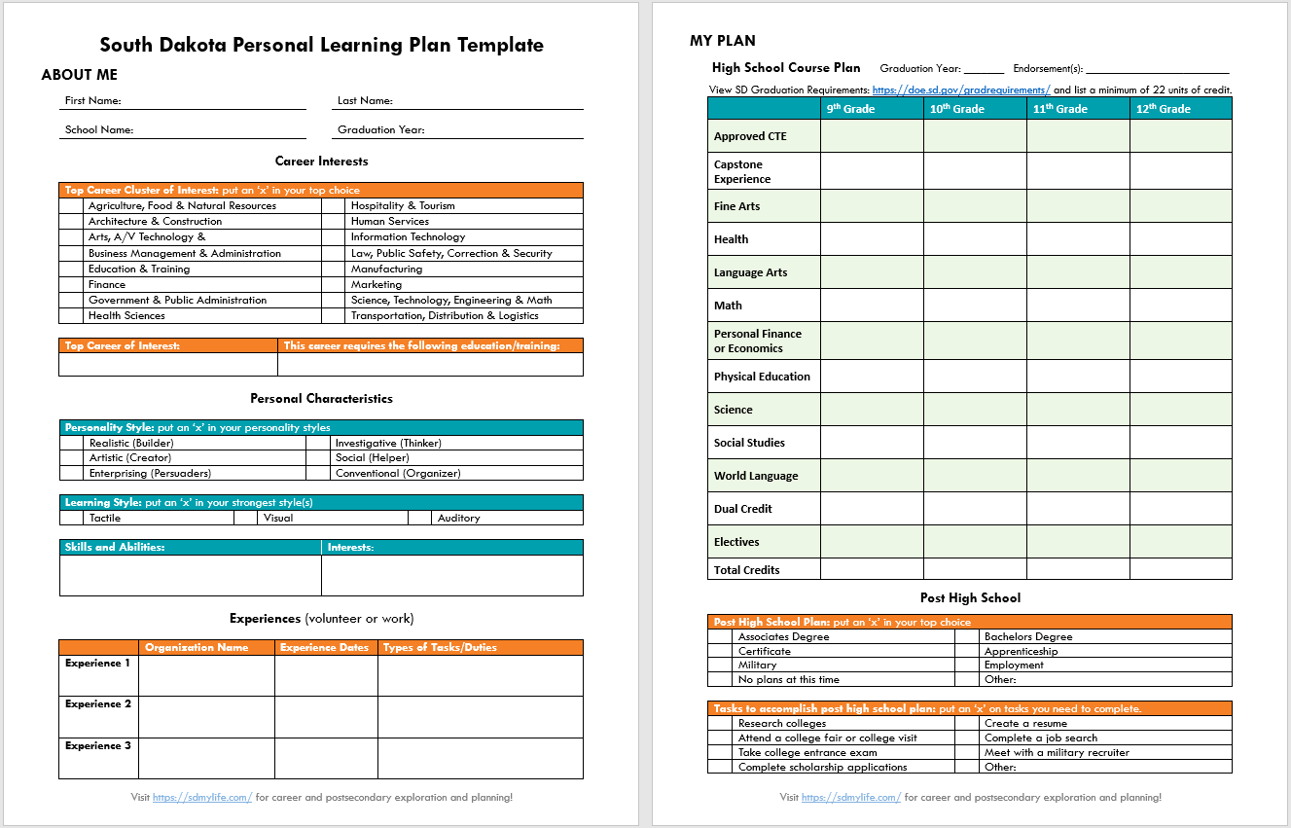
PLP Template by DOE

Slide 13
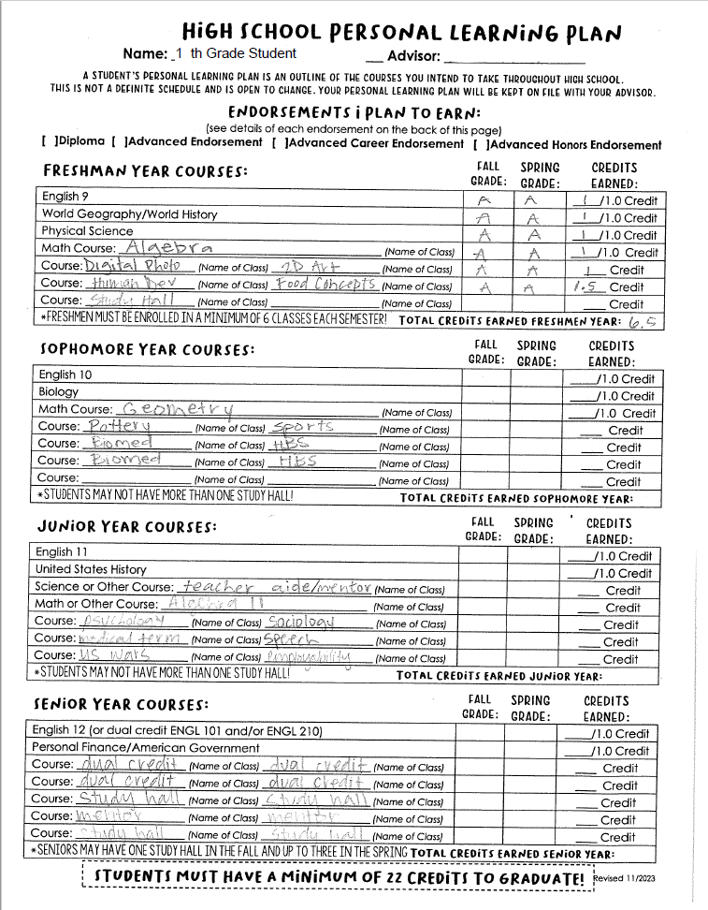
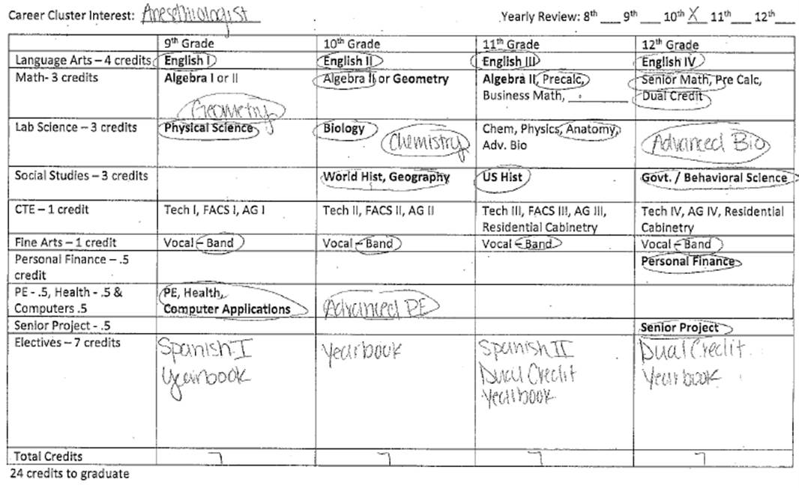
0
Recommendation: Include how many credits each course is worth.
This example includes both the course planner and transcript Audit.

Slide 14
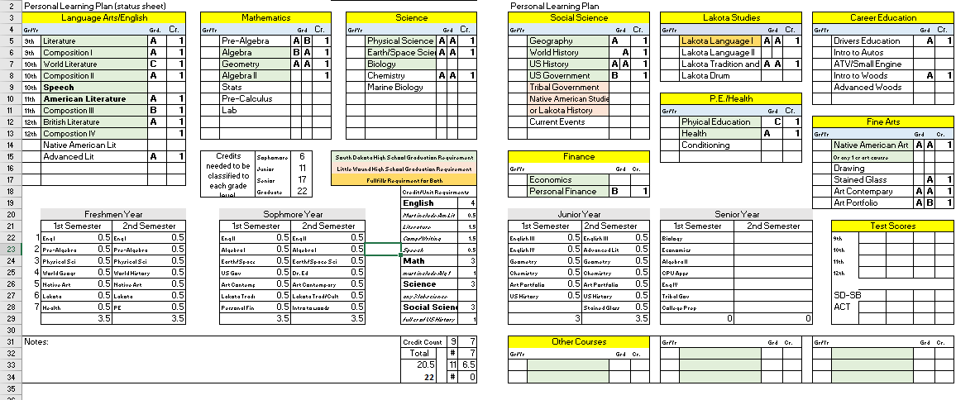

Slide 15
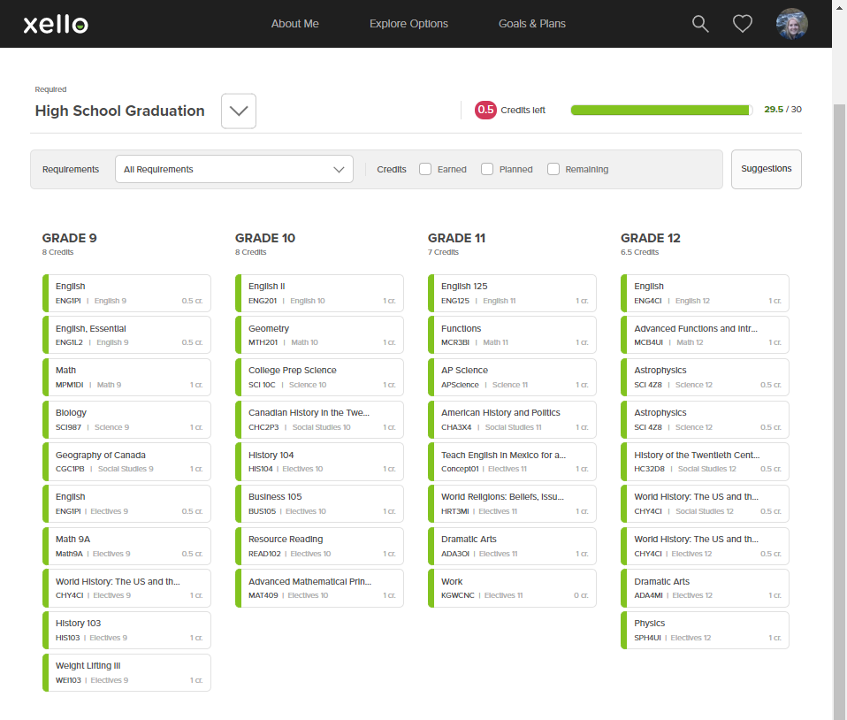
powered by
Contact our office for more information about setting up the Course Planner in SDMyLife powered by Xello.

Slide 16
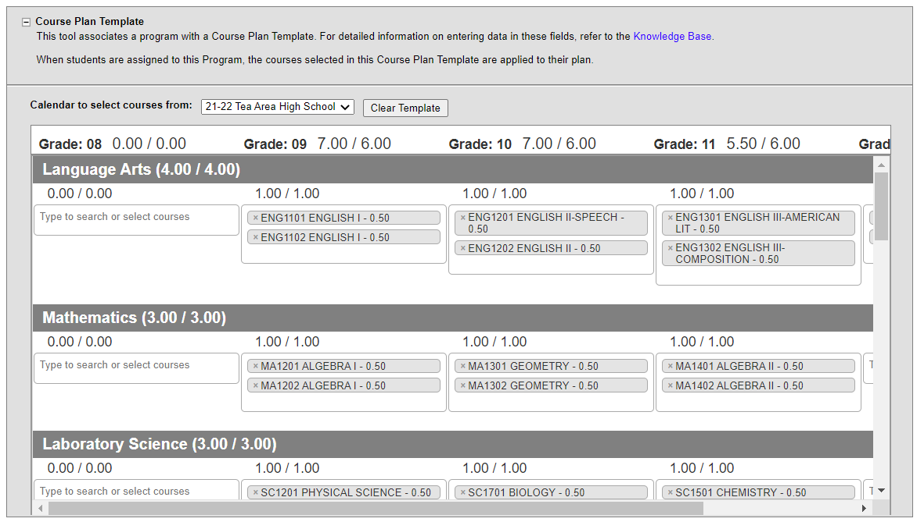

Slide 17
Less than 22 units of credit
Are students planning ahead? Is this a transcript audit?
No credit values added
Is the student planning to take a minimum of 22 units?
Red Flags
Only senior examples
Are underclassmen planning ahead or are these transcript audits?
Only career and life goals
Does the student have 22 units of credit planned?

Slide 18
Any Questions?

Slide 19
Thank you!
Kara Schweitzer
Kara.Schweitzer@state.sd.us

