Slide 1
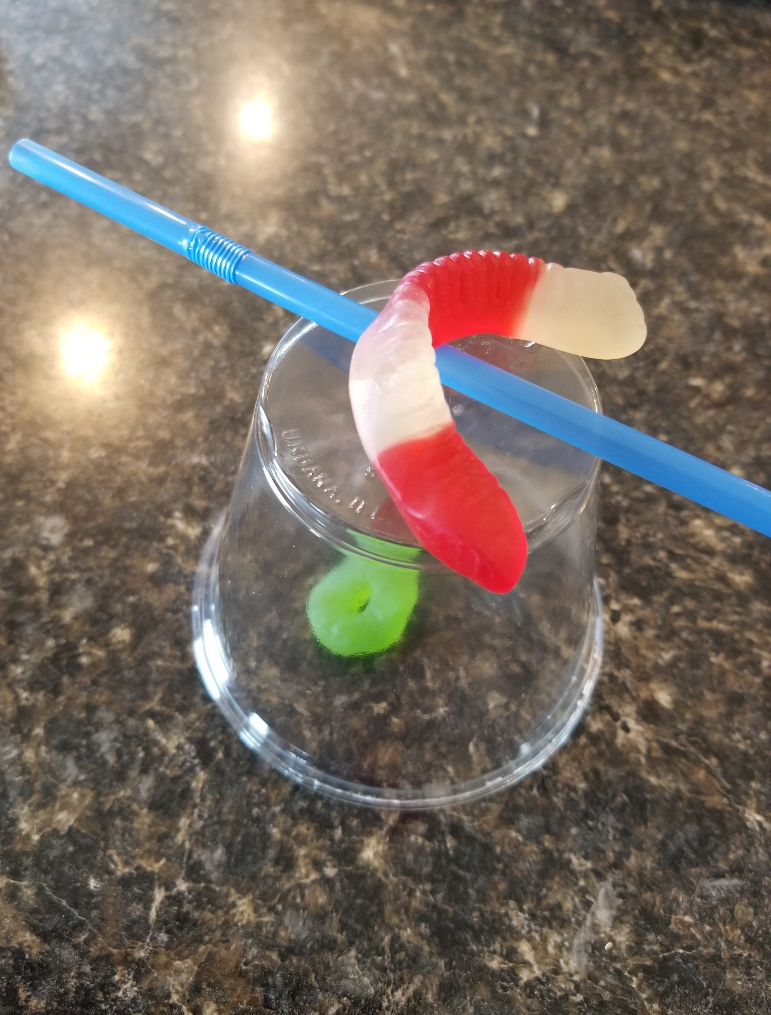
SAVING SAM

Slide 2
Poor Sam is a worm that has found himself in a rather unfortunate situation. His boat has capsized, and his life jacket is trapped underneath!
Poor Sam can’t swim! His oar, his only means of movement, has fallen into the rocky waters as well!
He now sits perched on top of his capsized boat and he needs our help!

Slide 3
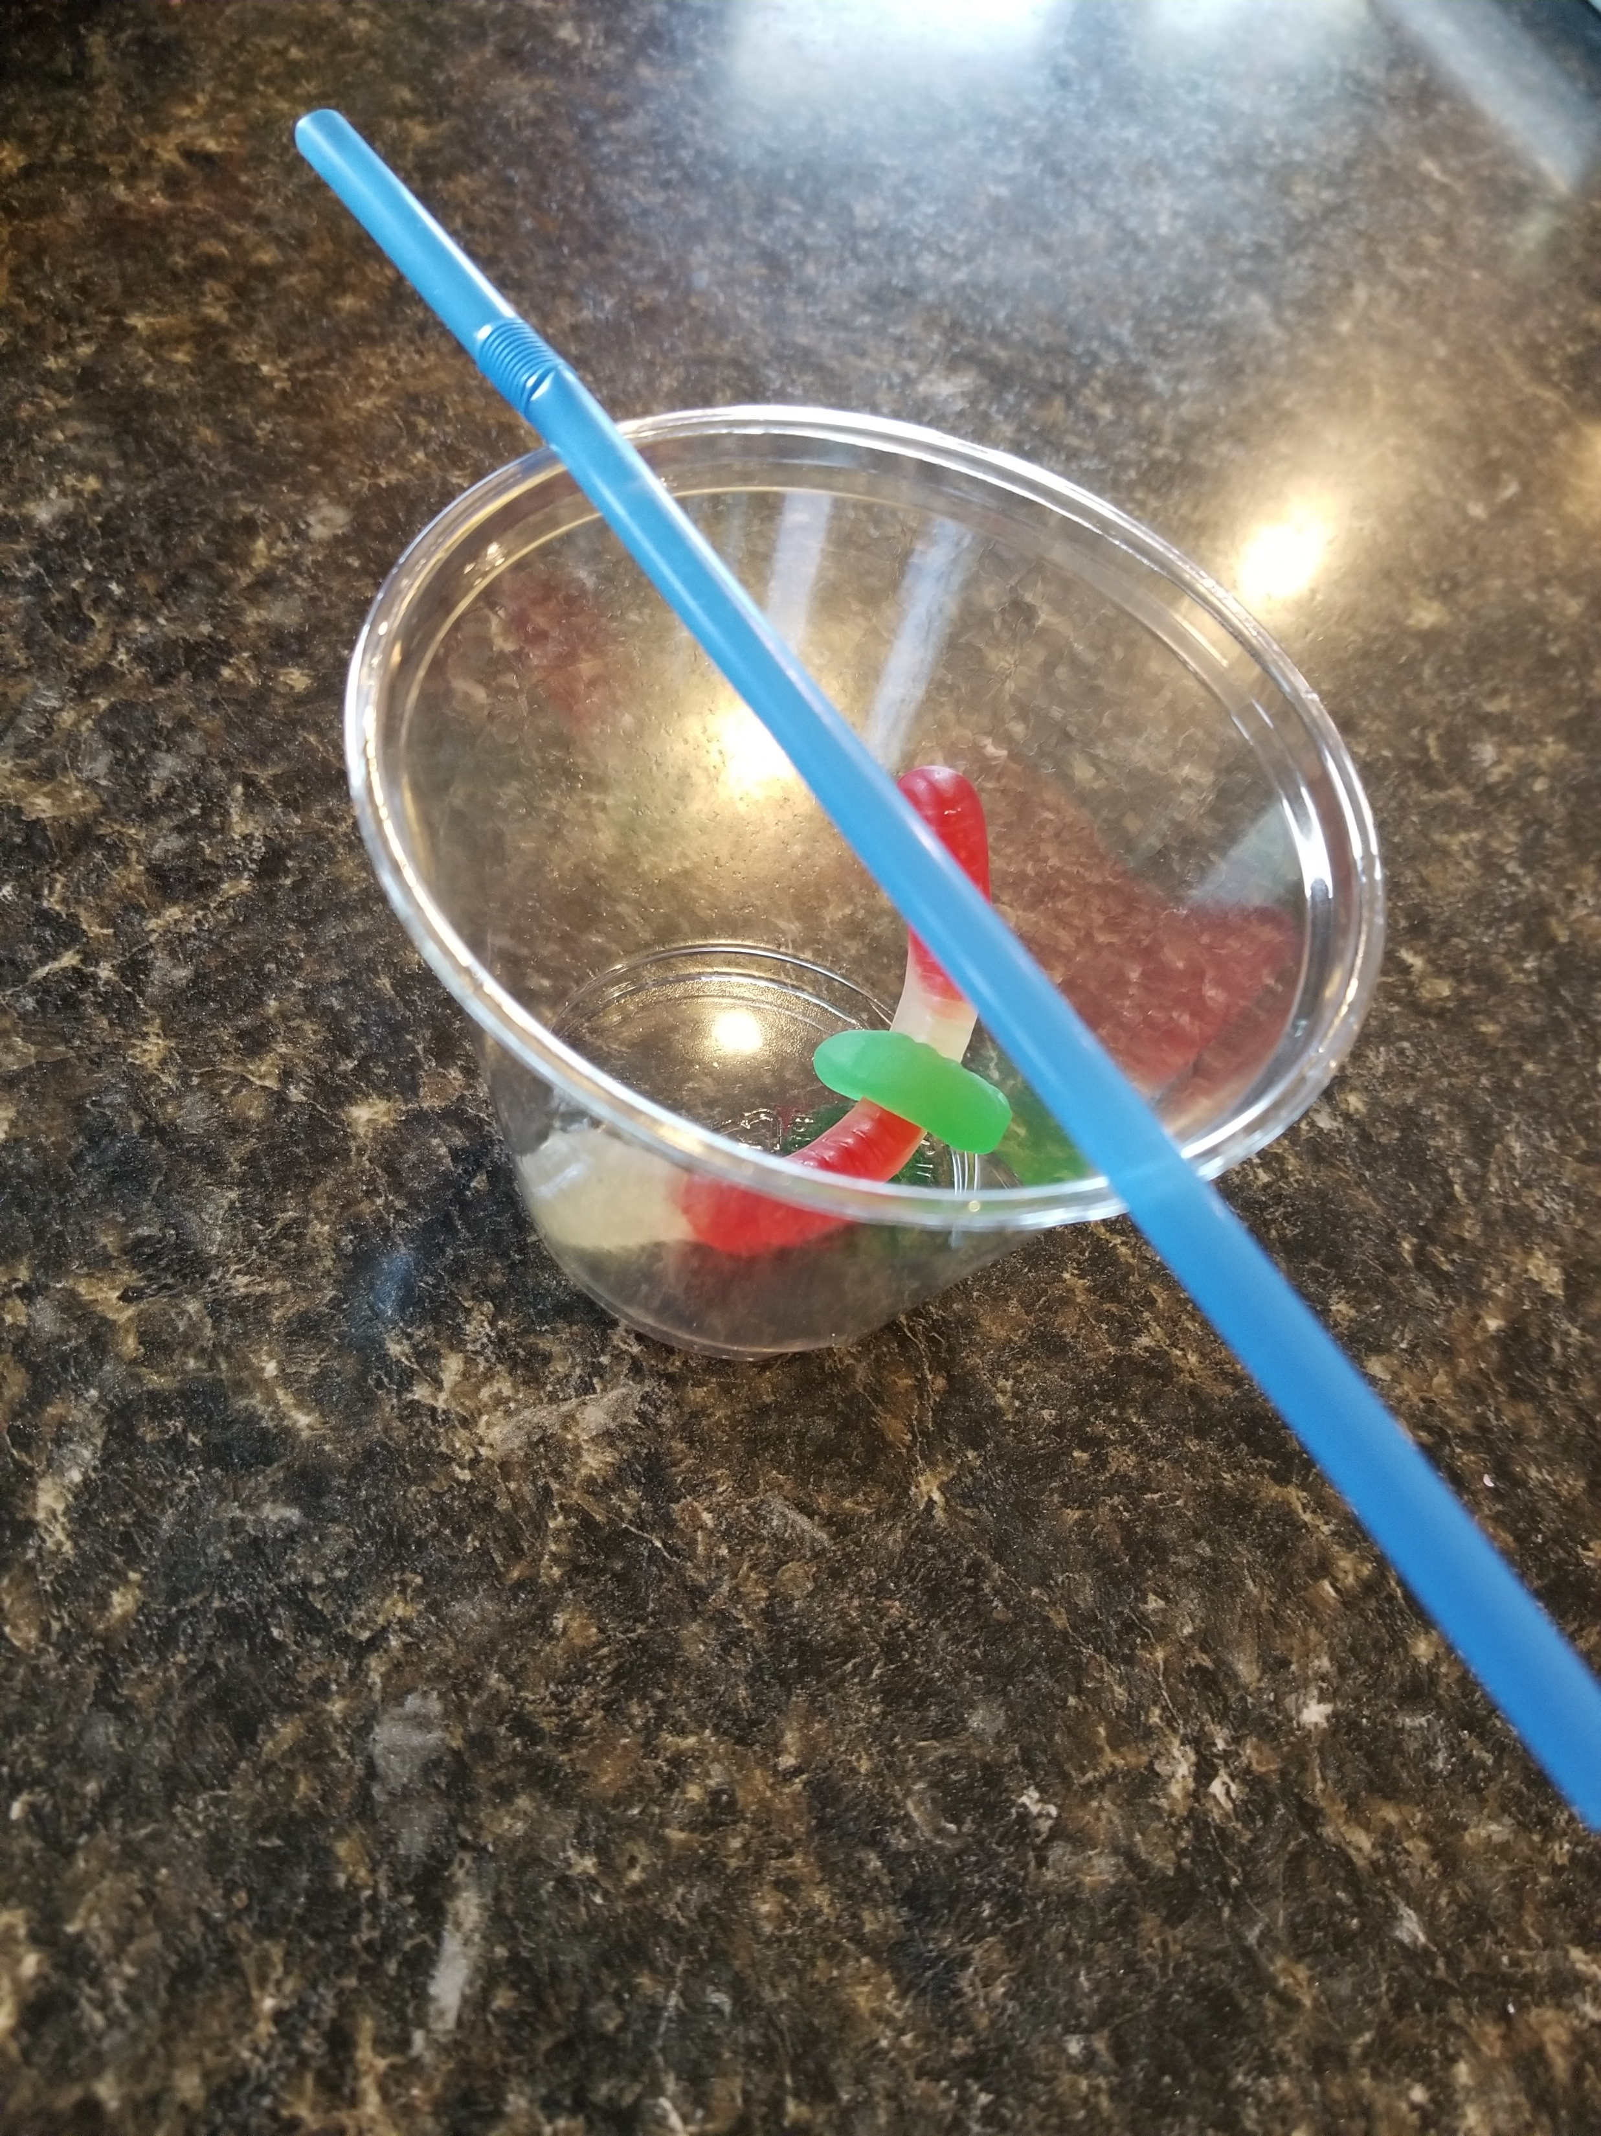
SAVE SAM!
Flip Sam’s boat over.
Get Sam back inside his boat.
Put his life jacket on him.
Place his oar horizontally across the top of his boat.
You can’t touch Sam, the life jacket, the boat or the oar with your hands.
Only use the paperclips supplied.
No stabbing Sam or his life jacket!
Sam can’t touch the water (floor or desk) because he can’t swim!

